Slide 1
Hilma af Klint 1862-1944
Video from Art Gallery of NSW YouTube channel, 2:20
https://www.youtube.com/watch?v=ujEoV4Tf_XQ

Slide 2
The Secret paintings, an exhibit of 128 paintings.
Video from Art Gallery of NSW YouTube channel, 3:34
https://www.youtube.com/watch?v=iQs31HjOelI

Slide 3
The Ten Largest, 1907
Video from Art Gallery of NSW YouTube channel, 1:01
https://www.youtube.com/watch?v=Qt7oGXu4EXU

Slide 4
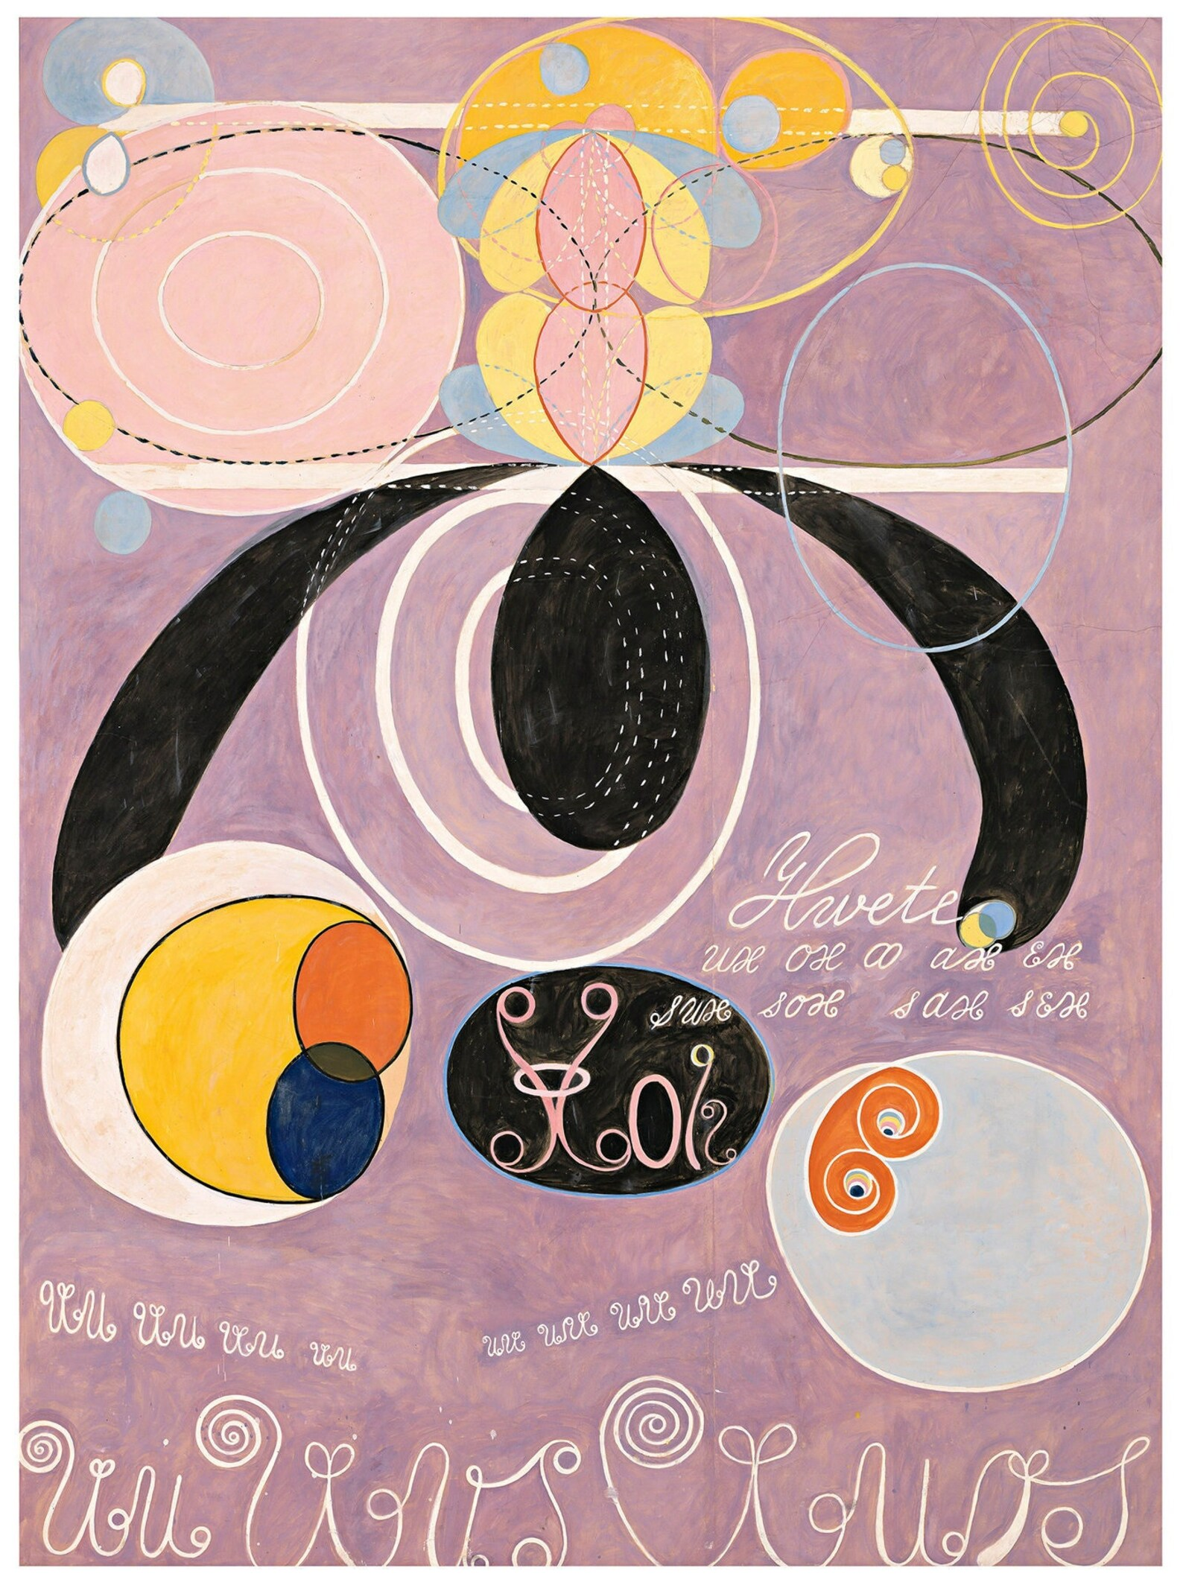
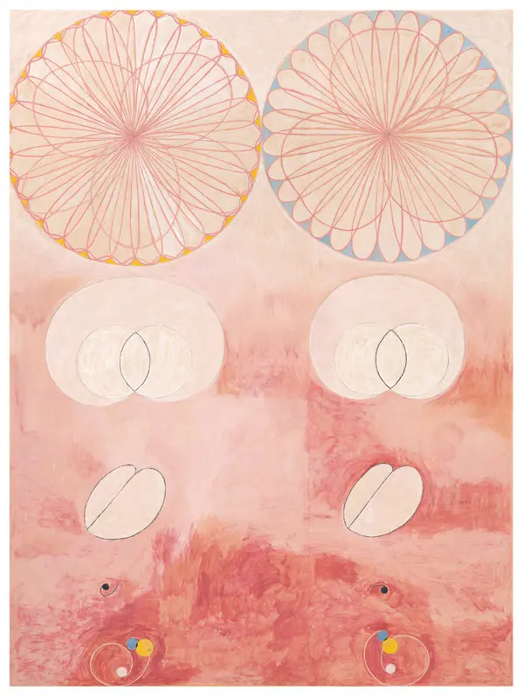
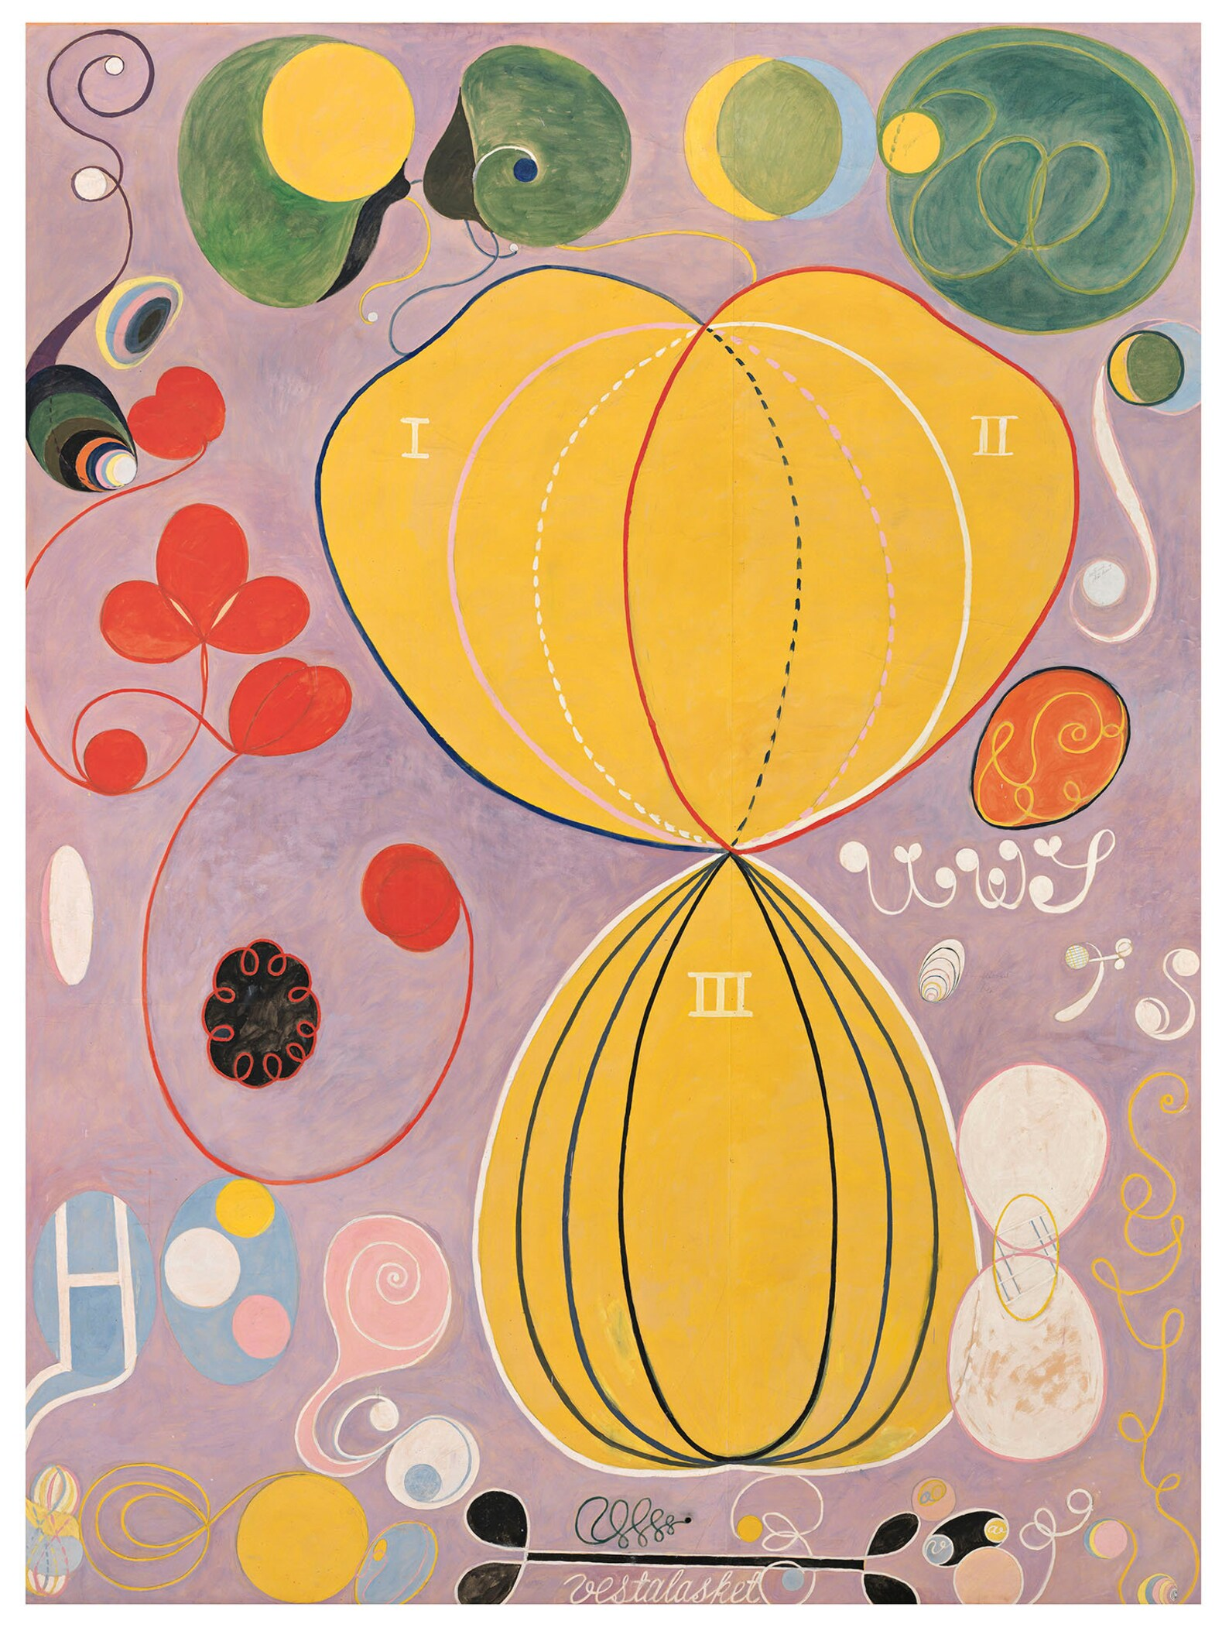
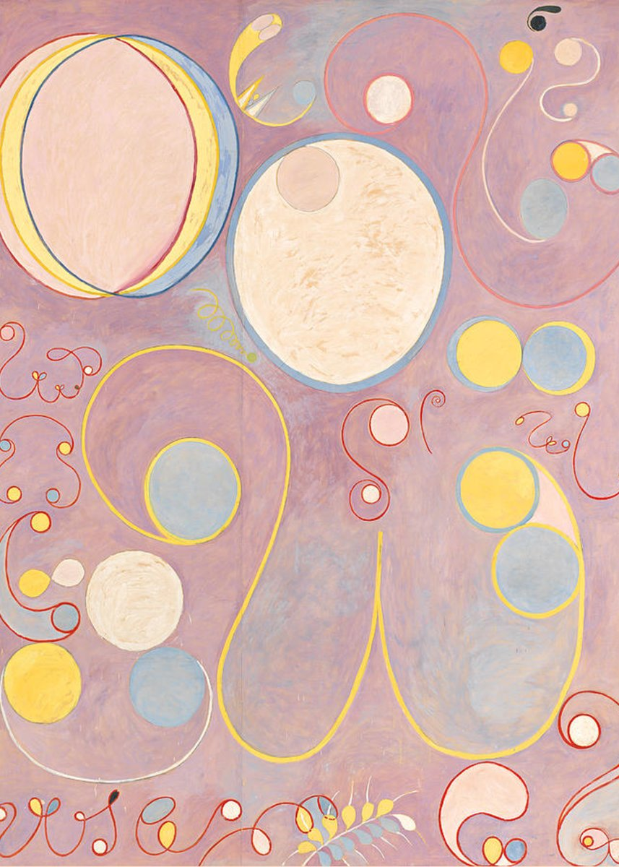
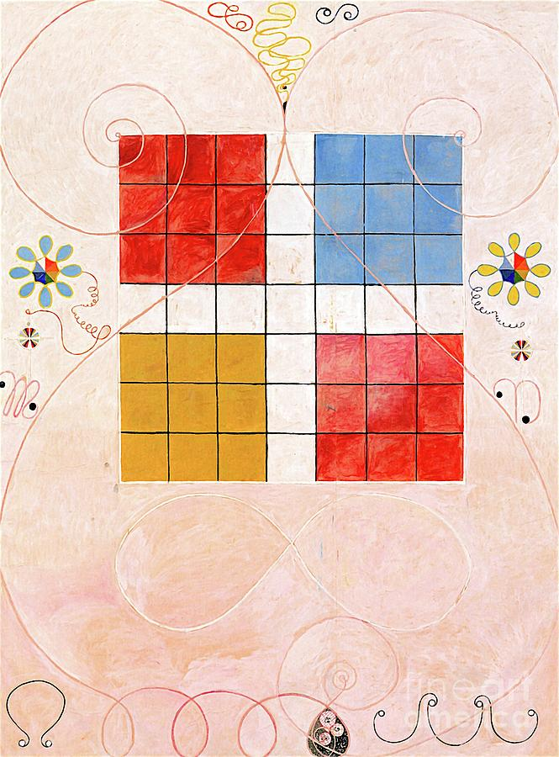
The Ten Largest, 1907 (roughly 10 feet tall paintings)

Slide 5
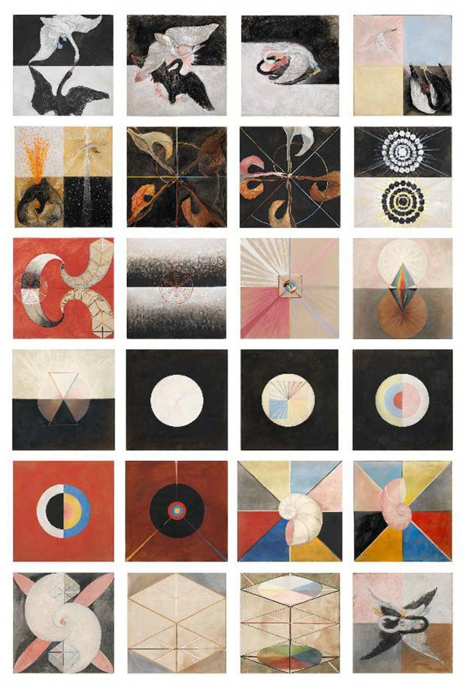
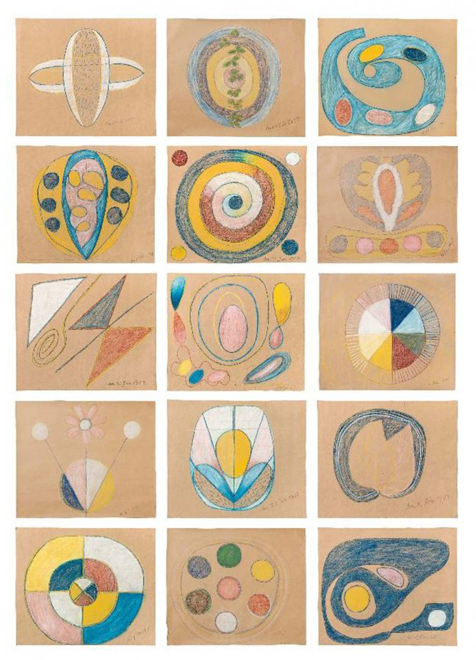
The Five 1896-1915
The Swan, 1915

Slide 6
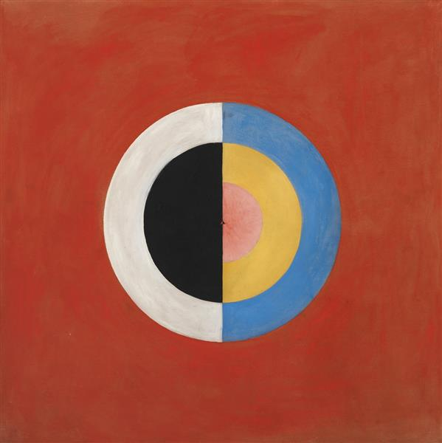
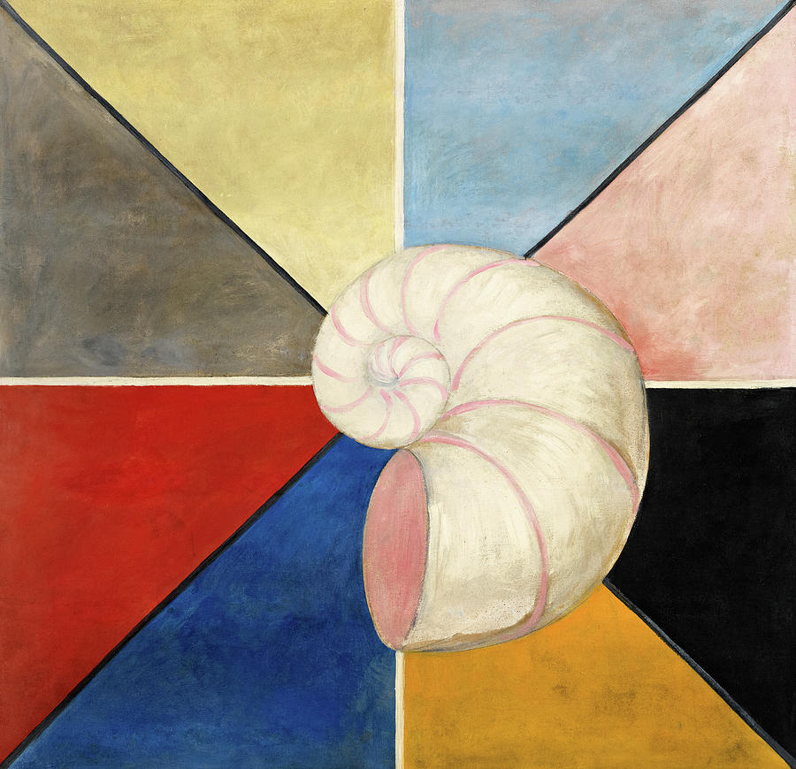
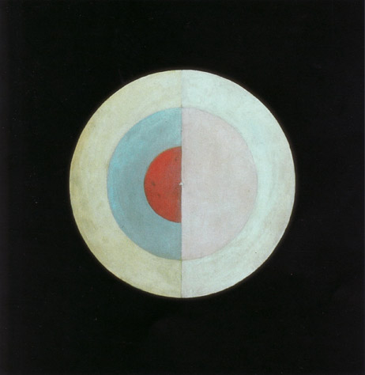
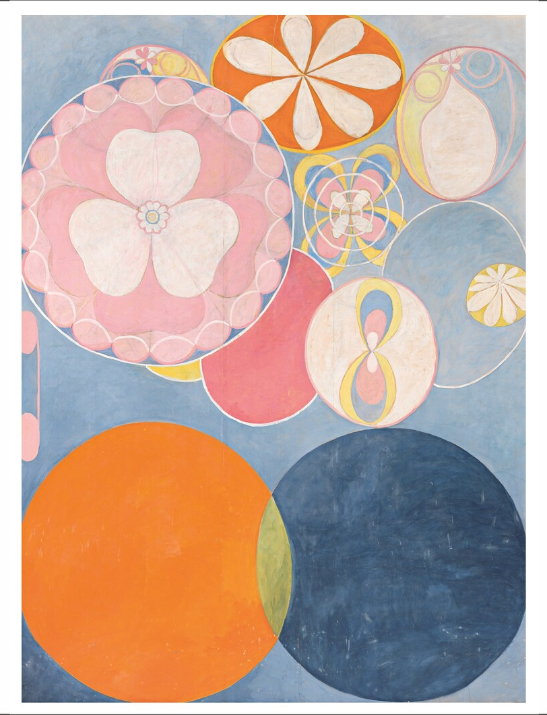
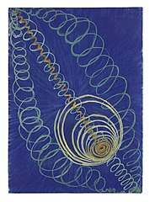
For your inspiration

Slide 7
Explore more!
Read more about the artist and her work.
https://www.artgallery.nsw.gov.au/whats-on/programs/hilma-af-klint-at-home/
See selected works, and find out where to catch a current exhibit.
https://hilmaafklint.se/
Use your computer to walk around in the 2021 exhibit at Art Gallery NSW.
https://www.artgallery.nsw.gov.au/art/watch-listen-read/virtual-visit/hilma-af-klint/

