Slide 1
Explore art

Slide 2
Value
Element of art

Slide 3

What is Value?

Slide 4
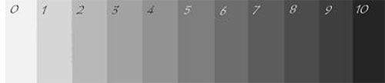
The value grayscale

Slide 7
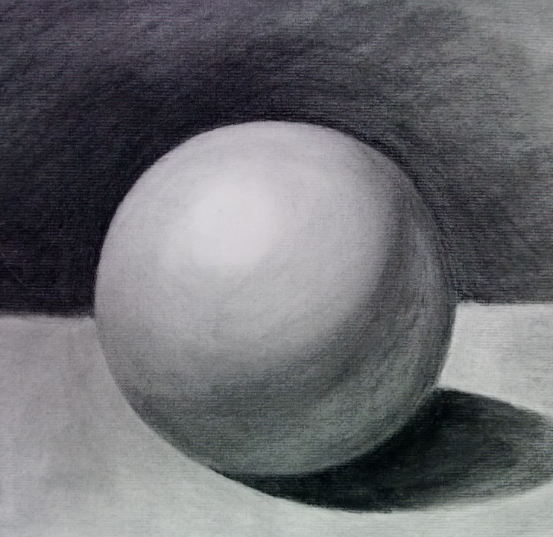

Slide 8
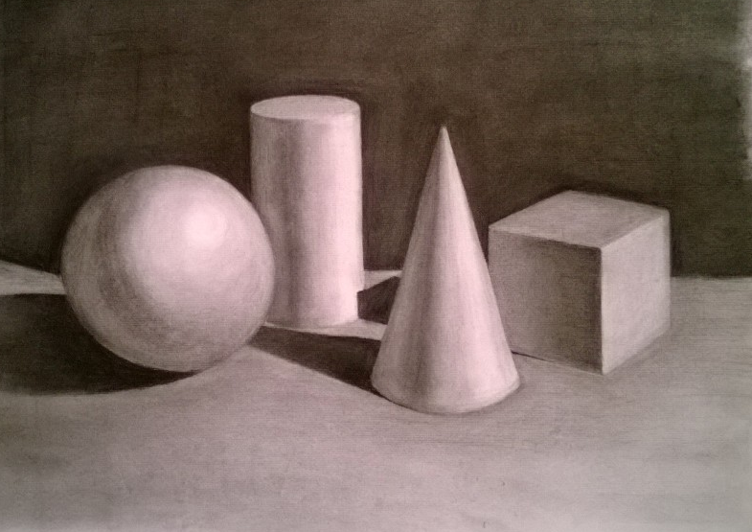

Slide 9
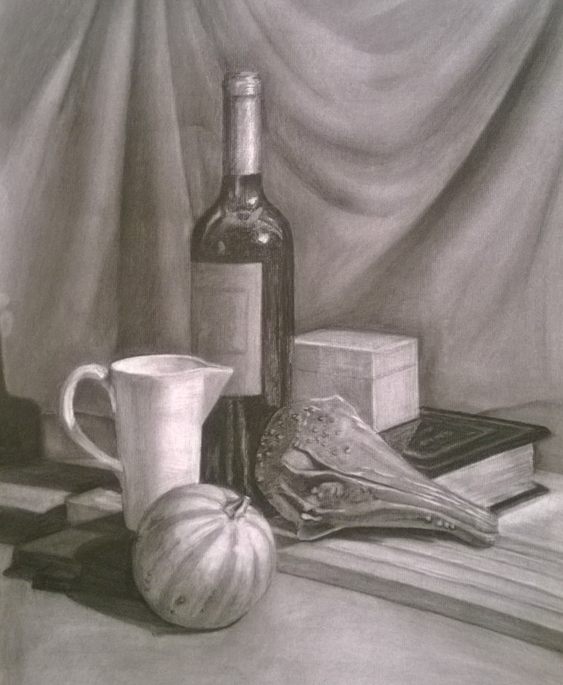

Slide 10
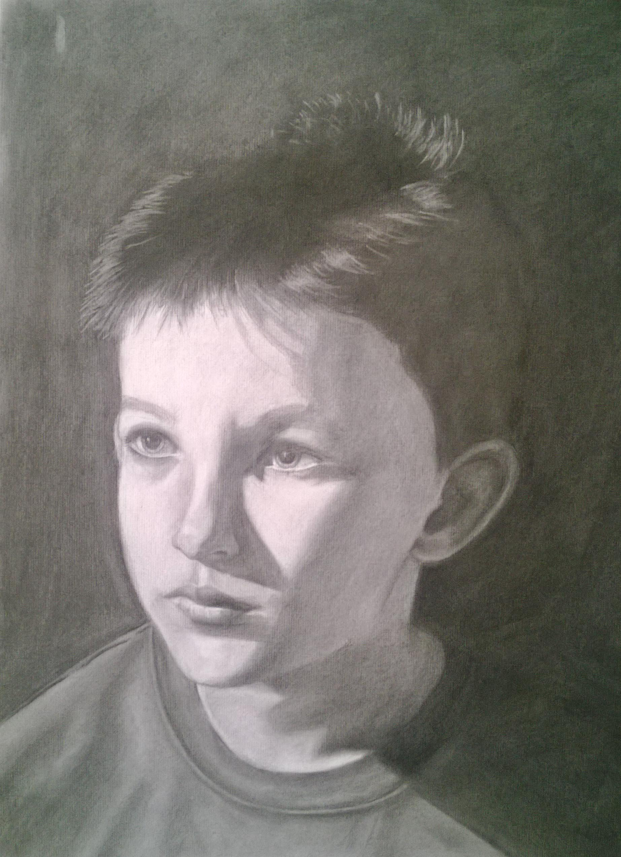

Slide 13
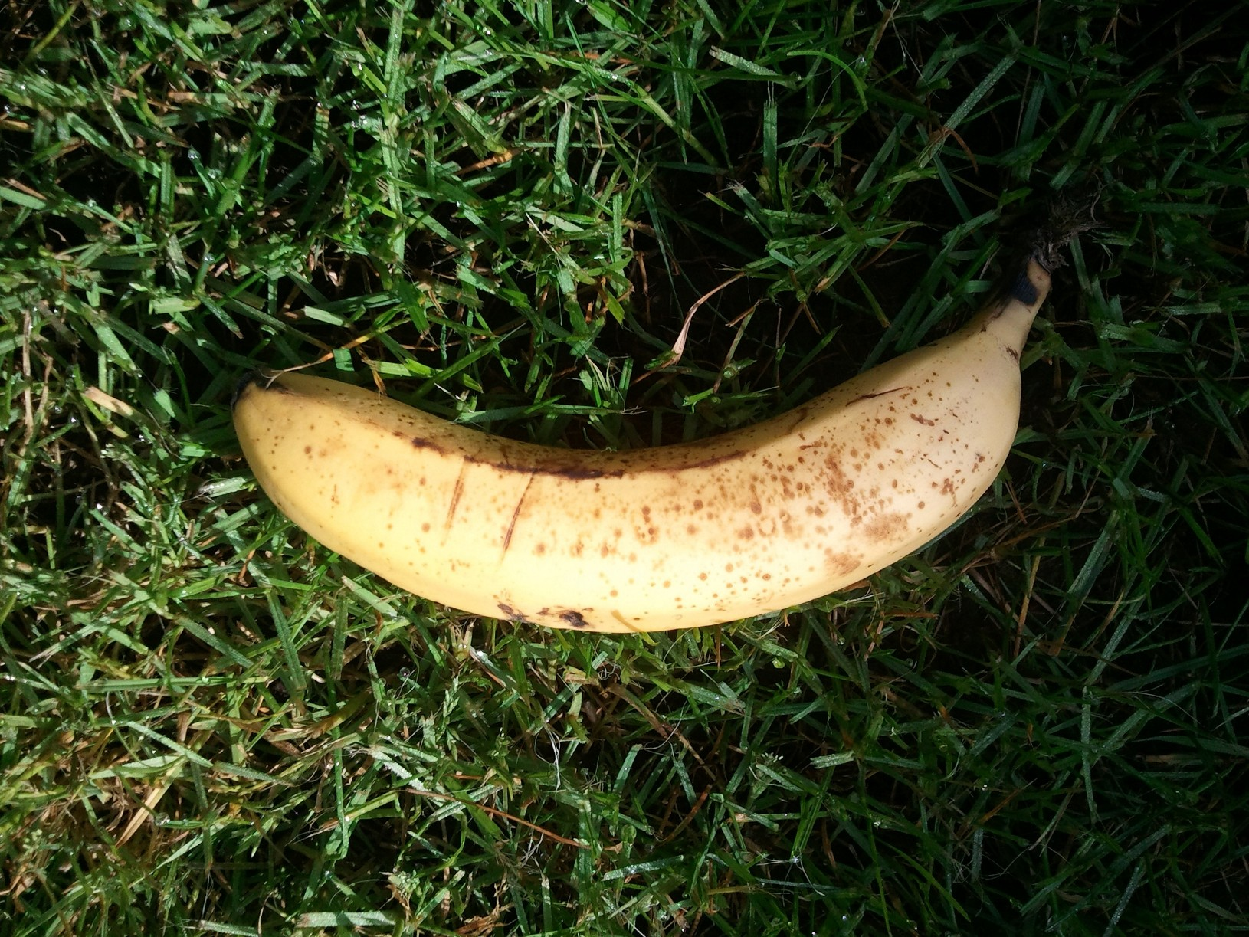

Slide 14
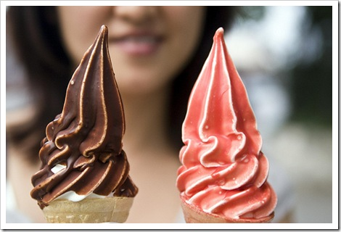

Slide 15


Slide 16
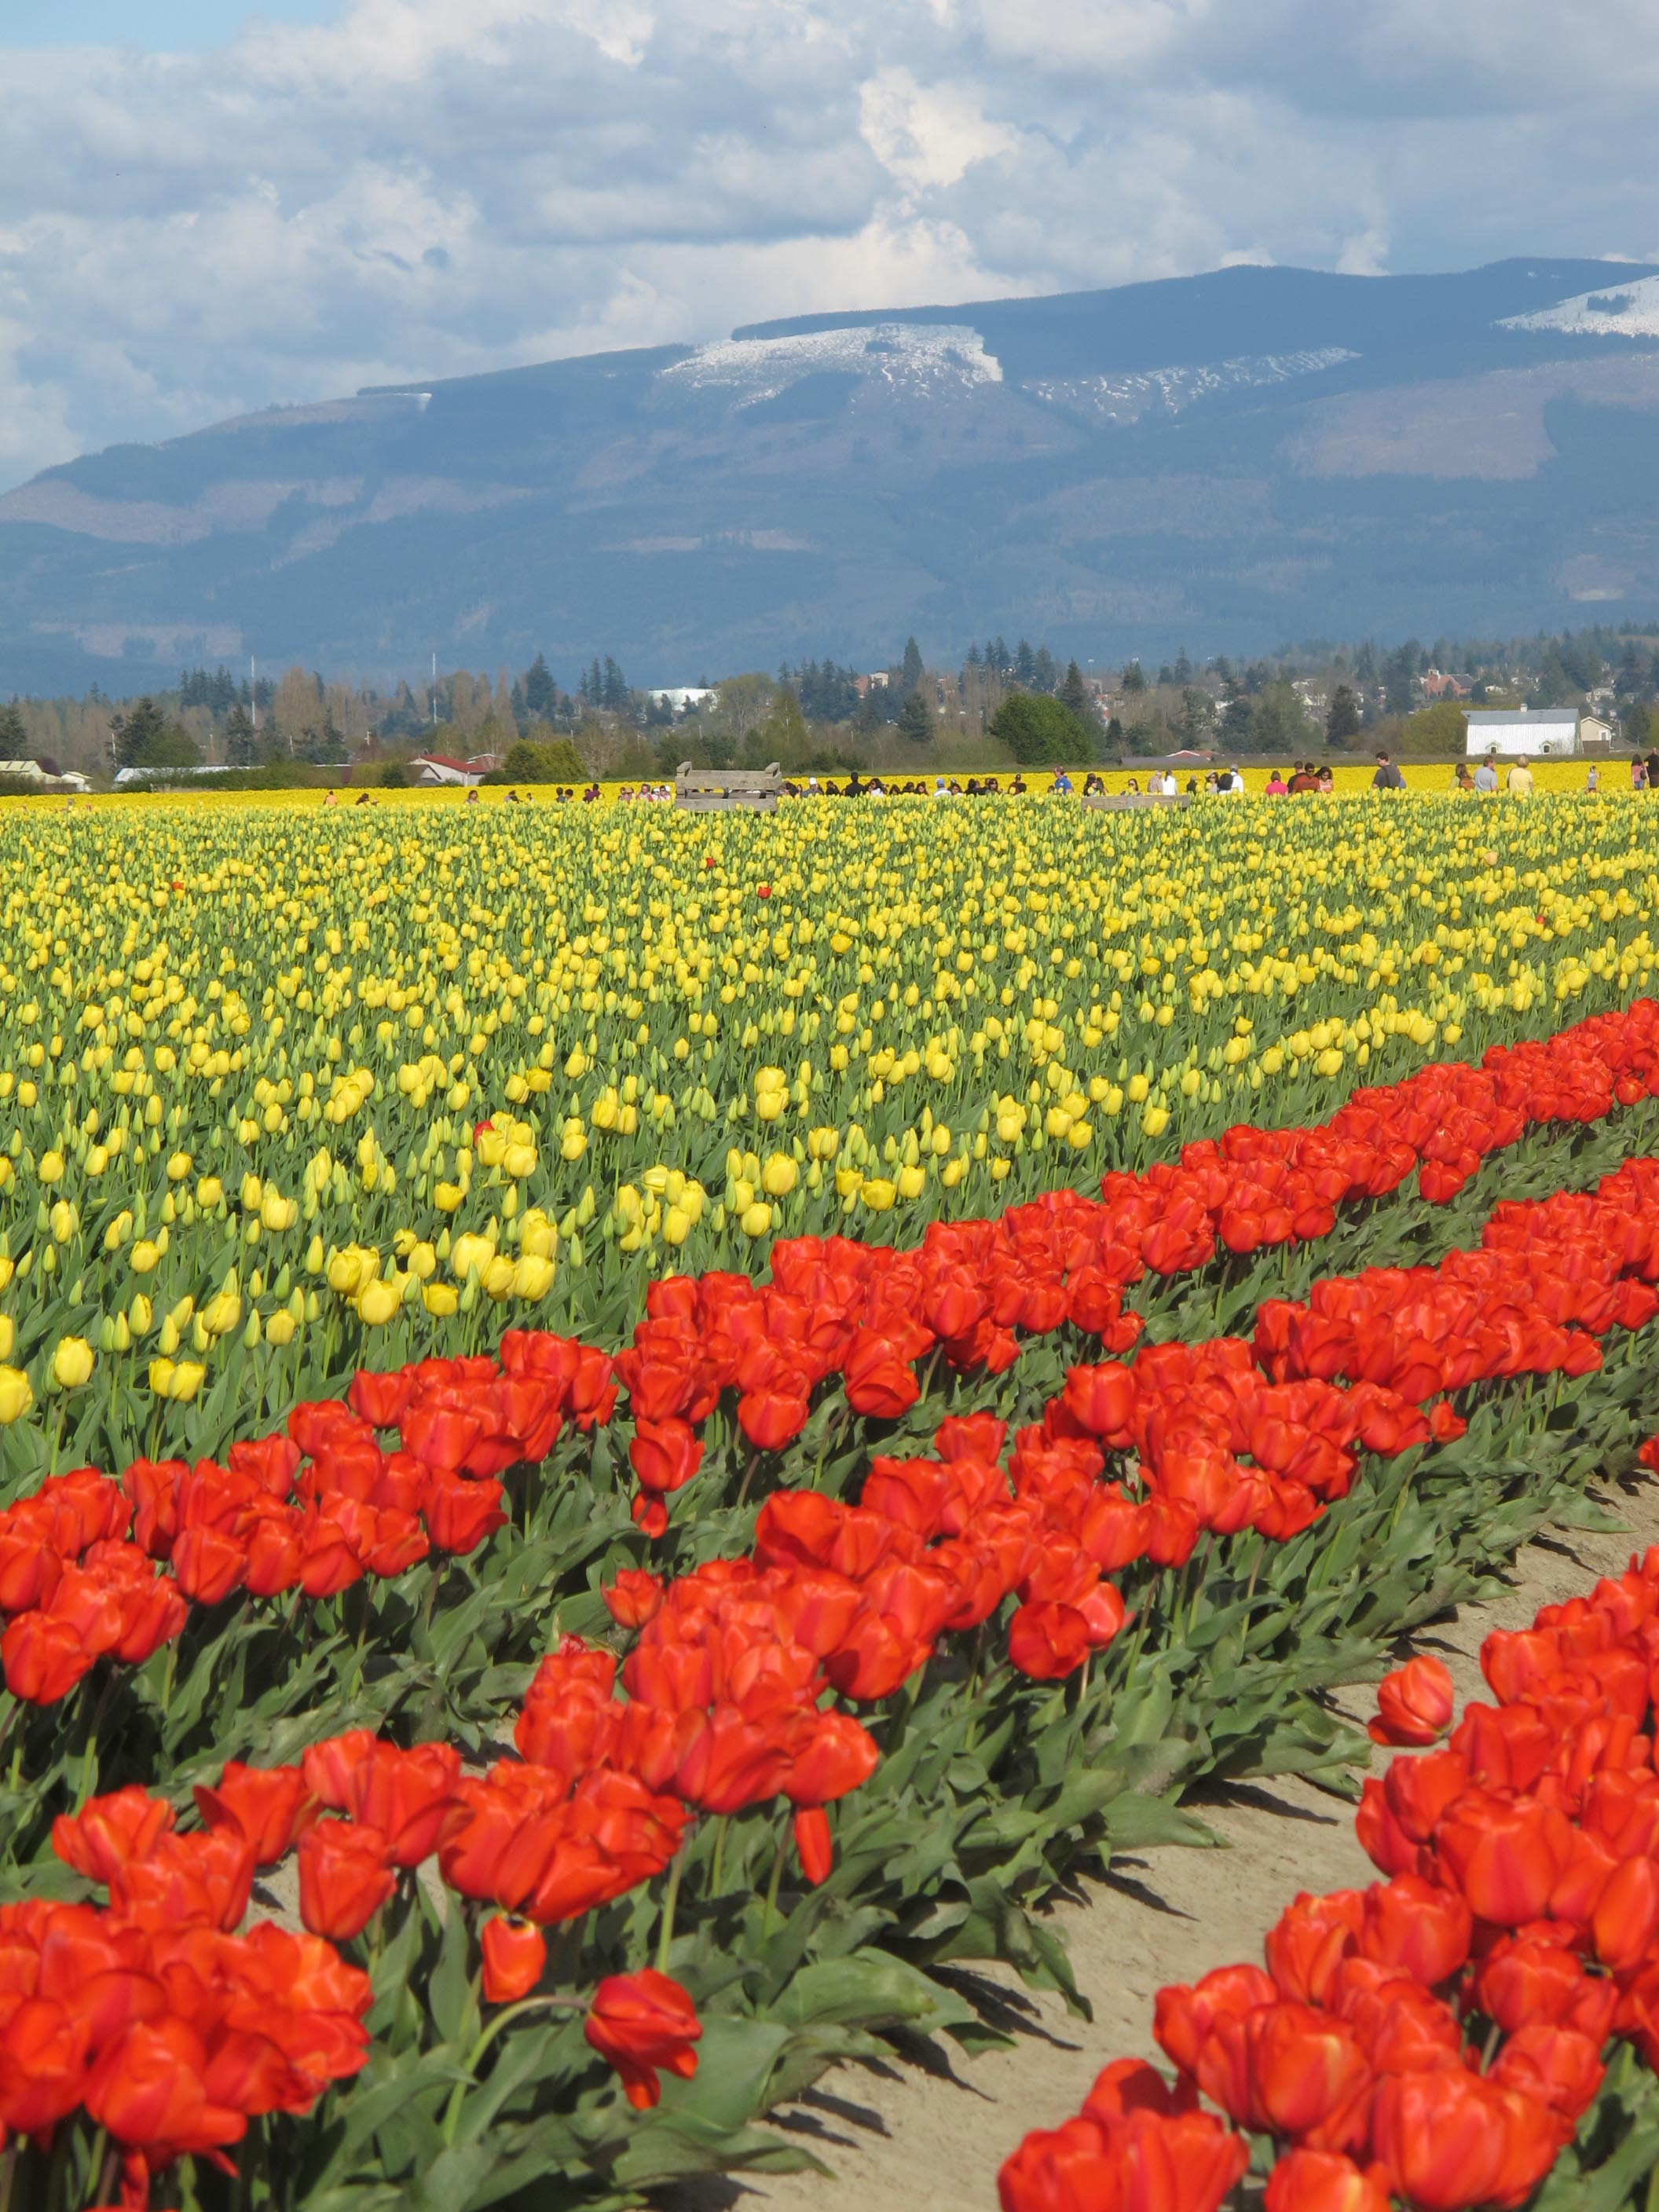

Slide 17
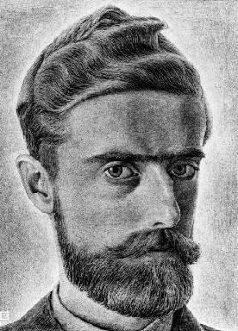
MC Escher
June 1898 – March 1972

Slide 18

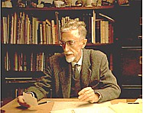
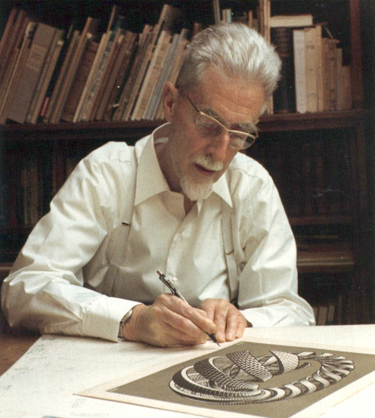
Early life
BORN IN THE NETHERLANDS
SICKLY CHILD
DIDN’T DO WELL AT SCHOOL
LOVED TO DRAW!

Slide 19
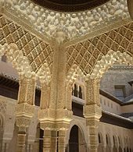
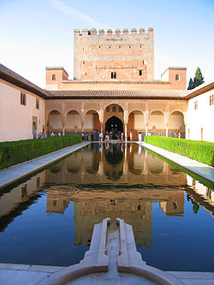
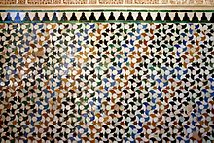
Later life
STUDIED ARCHITECTURE AND DECORATIVE ARTS.
VERY INFLUENCED BY THE BUILDINGS AND ARCHITECTURE
LIVED IN ITALY, SWITZERLAND AND EVENTUALLY BACK TO THE NETHERLANDS

Slide 20
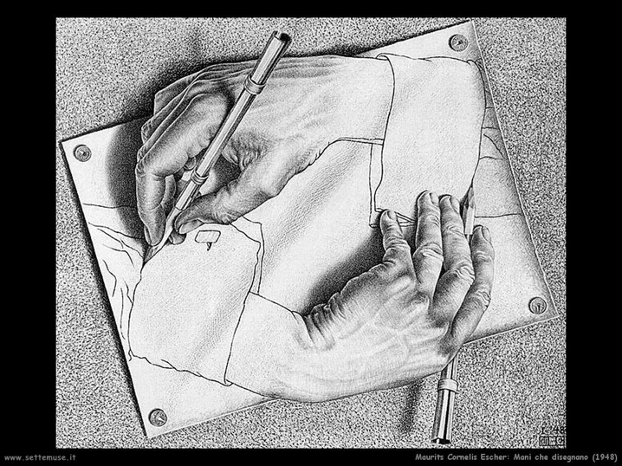
Drawing Hands
1948

Slide 21
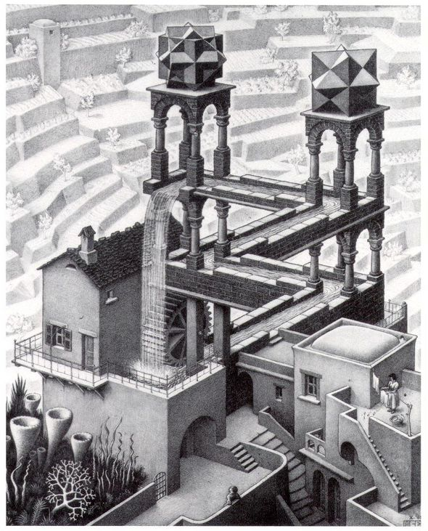
Waterfall
1961

Slide 22
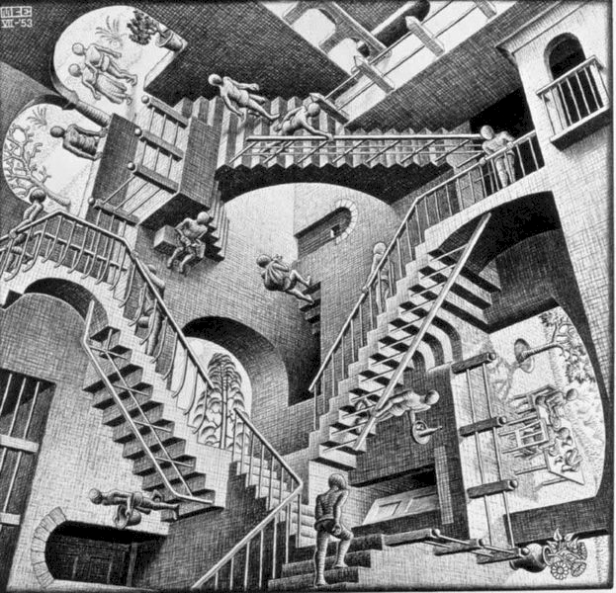
Relativity
1953

Slide 23
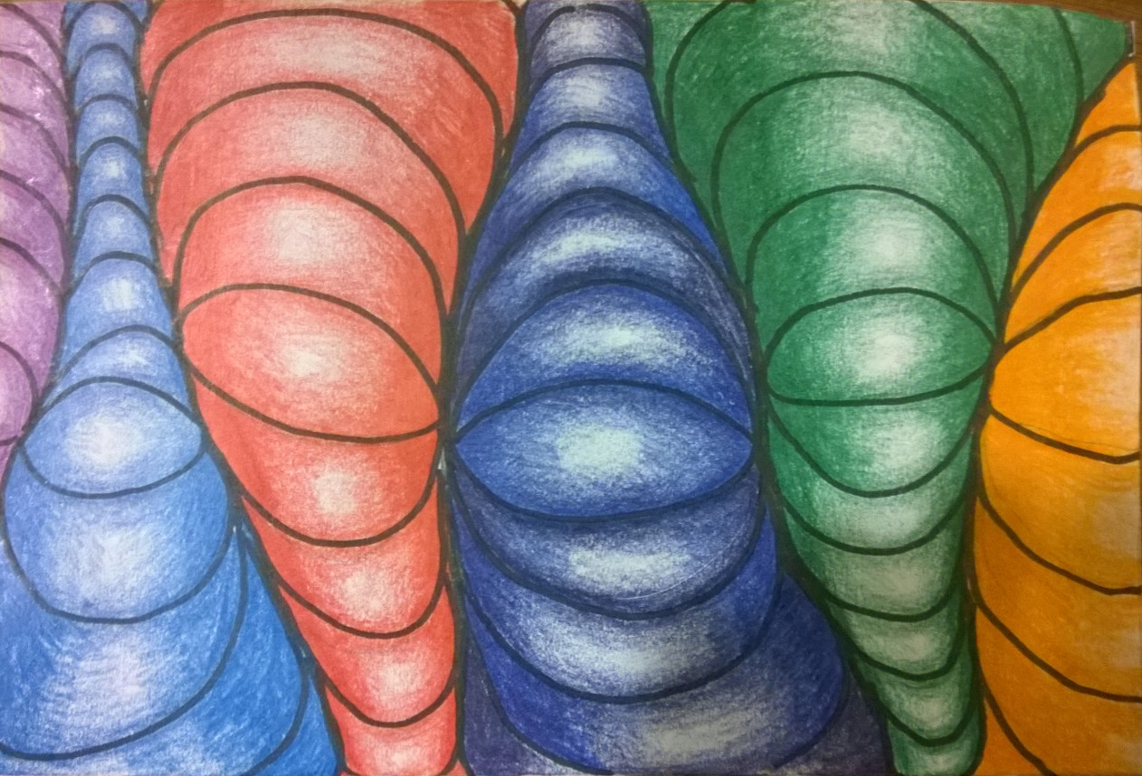

Slide 24
