Slide 1
Explore Art

Slide 2
Element of Art
Texture

Slide 3
What is Texture?
• Valuable because it brings in another sense besides sight
• Appeals to our sense of touch
• Artists may try to recreate the illusion of texture, or add real texture to stimulate our tactile nature.

Slide 4
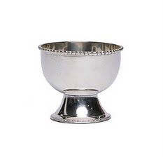
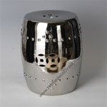
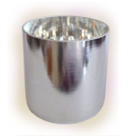
• Texture is related to value, in that it’s created by modifying the light on a surface
• We don’t need to touch a shiny silver bowl to know its surface is hard, smooth, and polished
Notes:
When you use a continuous line to form an enclosed area, you’ve created a shape, On paper, a shape is a flat enclosed area that can be measured by its height and width.
Geometric shapes have definded edges. They are precise and regular. Man-made objects are often made with geometric shapes.
Here are are simple geometric shapes
Square, triangle, Rectangle, Circle, Oval

Slide 5
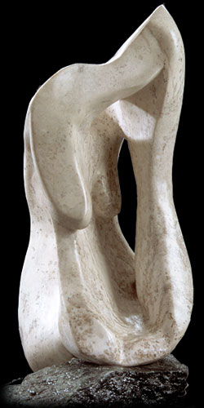
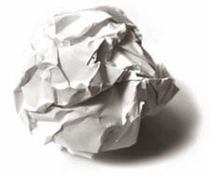
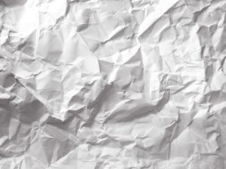
• We can “sense” a crumpled piece of paper’s texture because of the hundreds of broken, abrupt value changes
• In sculpture, hammering, carving, embossing or molding the surface
of the material adds texture

Slide 6
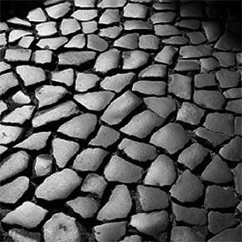

Slide 7
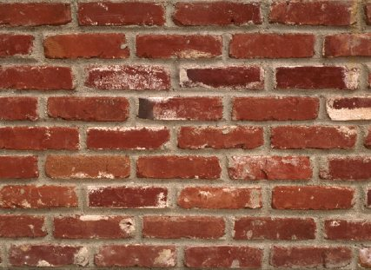

Slide 8
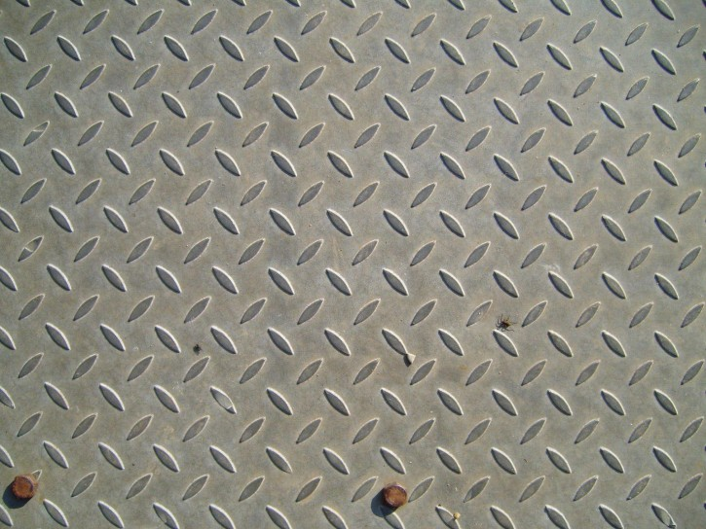

Slide 9
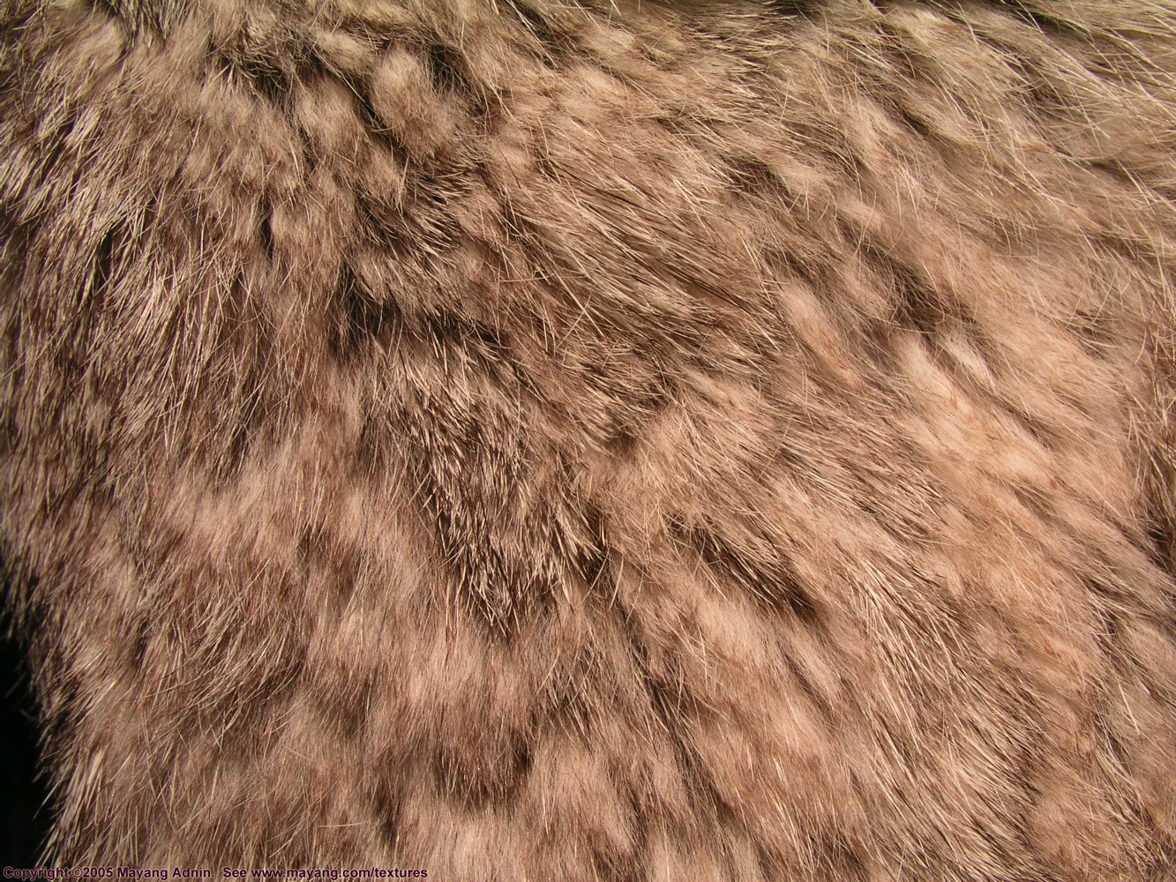

Slide 10
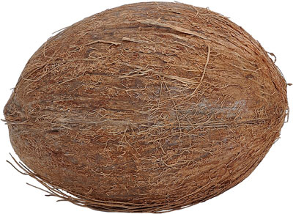

Slide 11
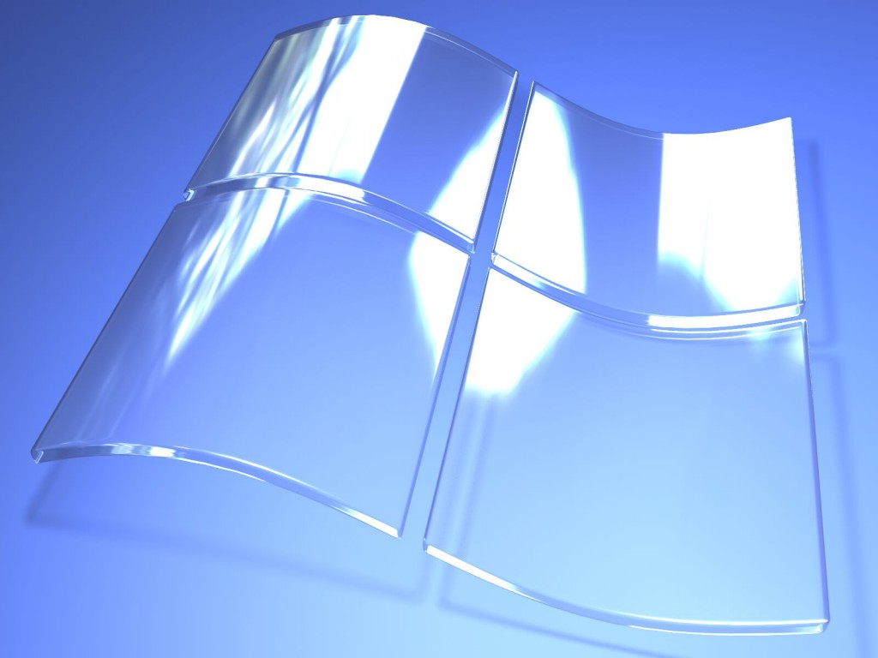
Notes:
It may surprise you to see the relationship between geometric shapes, which sounds like math class, and creating a piece of art. But geometric shapes can create a striking visual effect when you repeat them to create patterns, as shown in this quilt.
Even though this quilt uses many colors and patterns of material, the repeated geometric shapes bring a sense of orderliness and unity to the piece

Slide 12
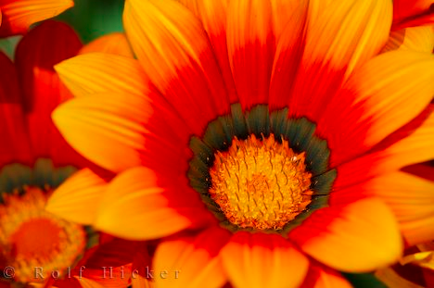

Slide 13
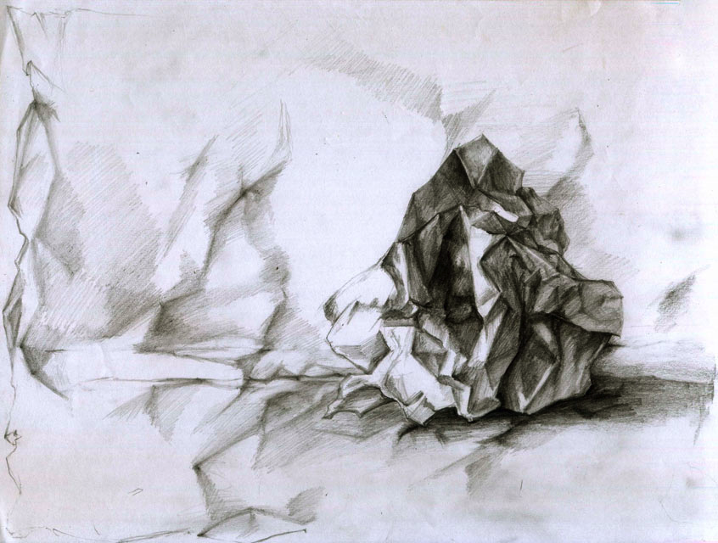
How do artists produce texture in art?
• Value is the key
• Changing light
• Highlights and shadows

Slide 14
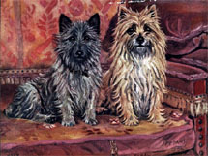
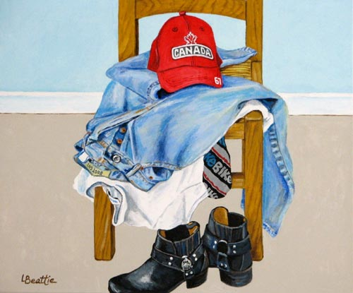
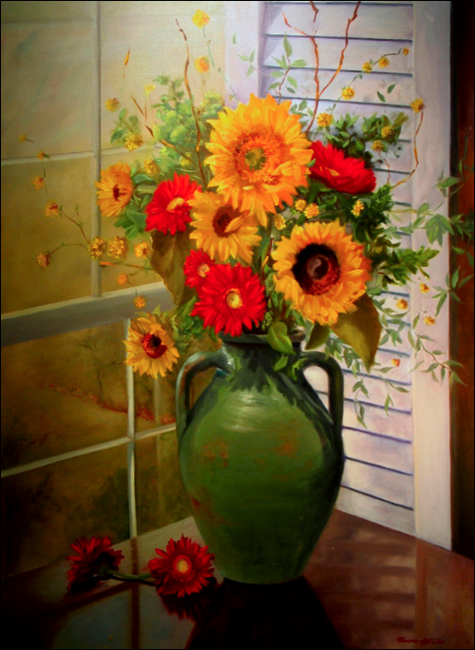
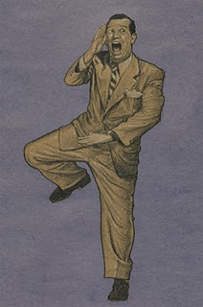

Slide 15
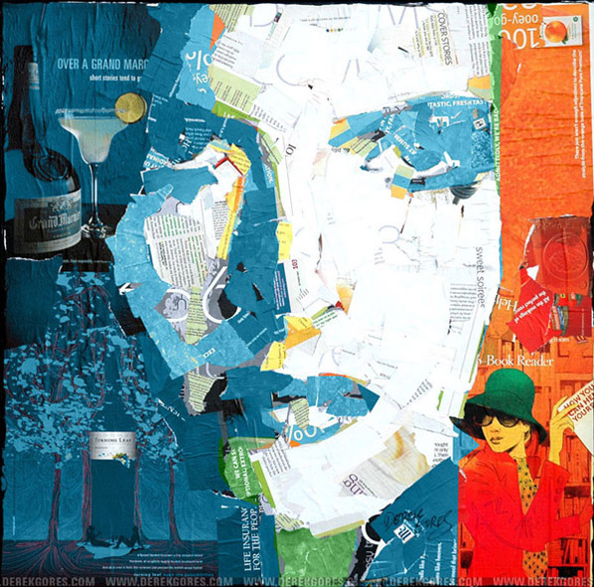
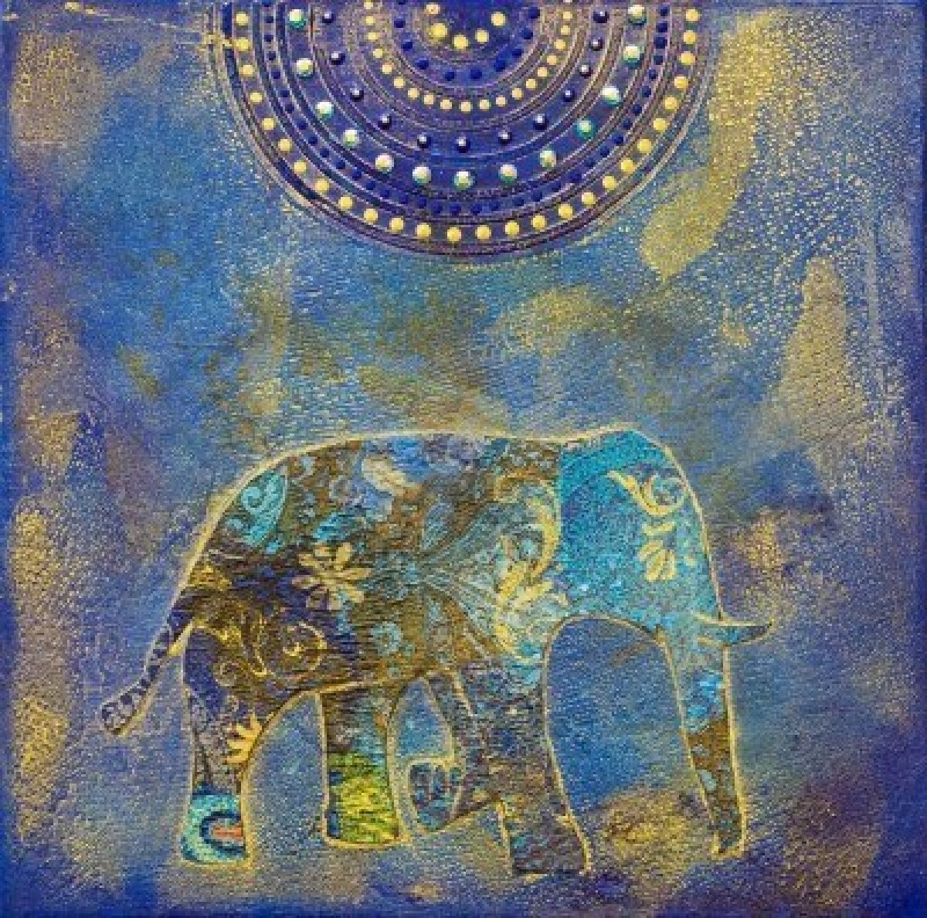
How do artists produce texture in art?
• Texture can also be produced by pasting objects onto the canvas
• This is called collage

Slide 16
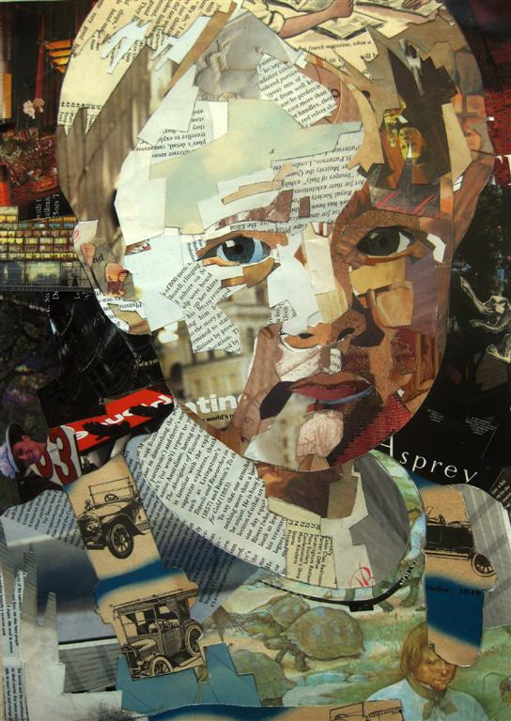
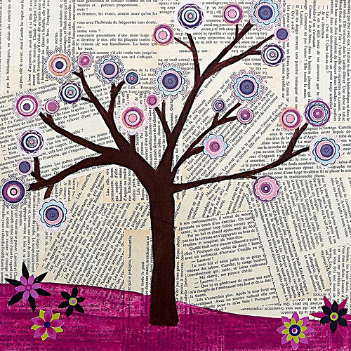
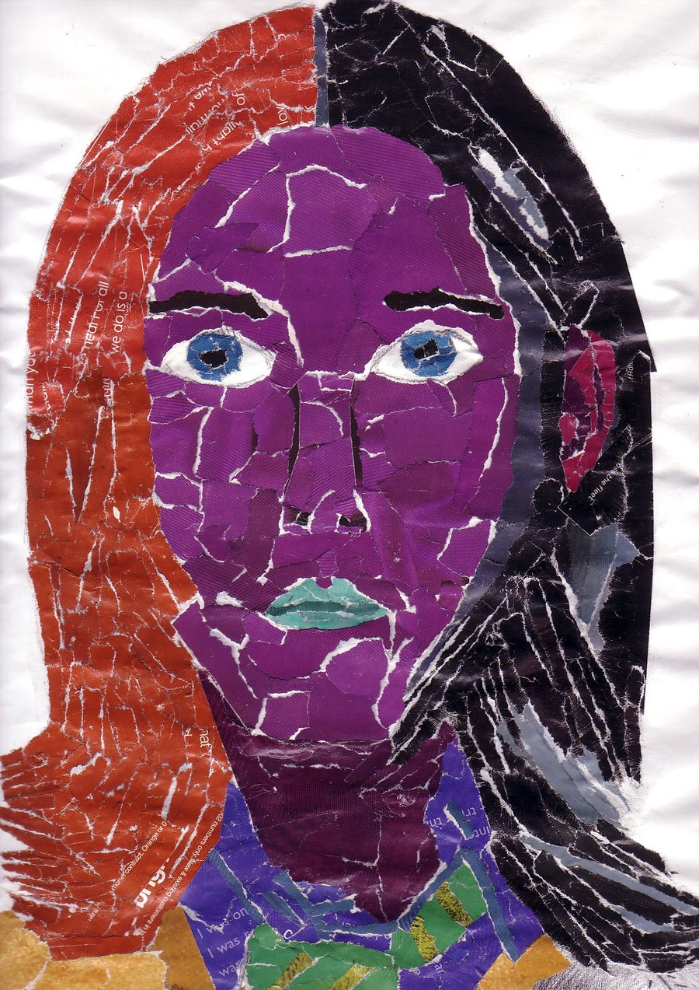
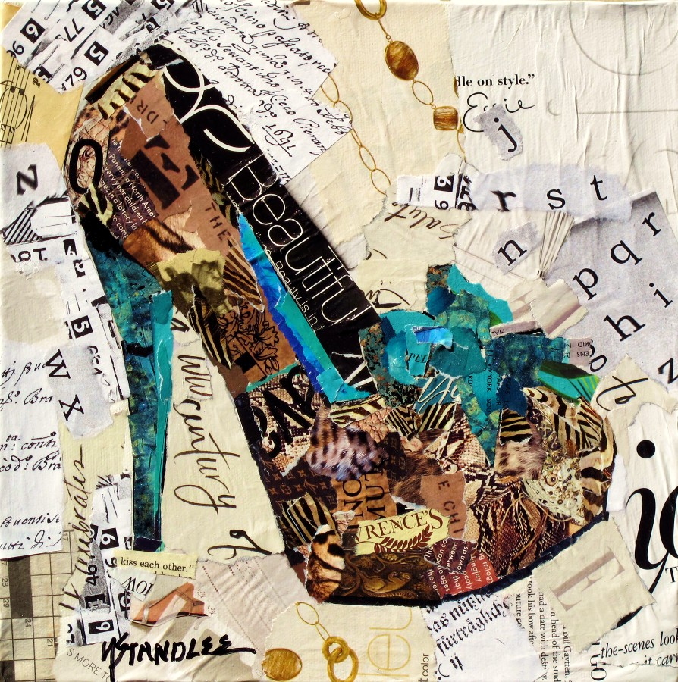

Slide 17
