Slide 1

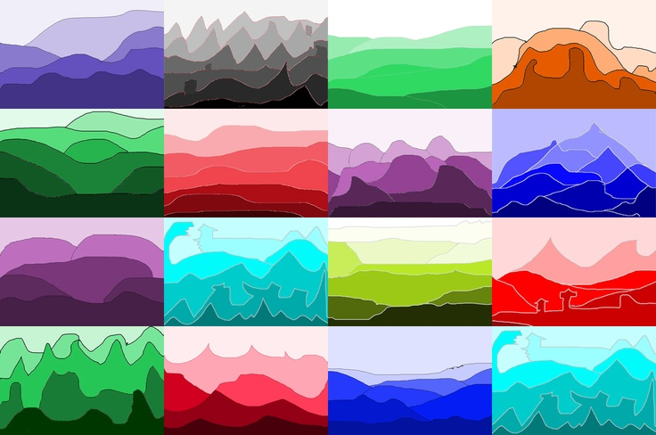

Slide 2
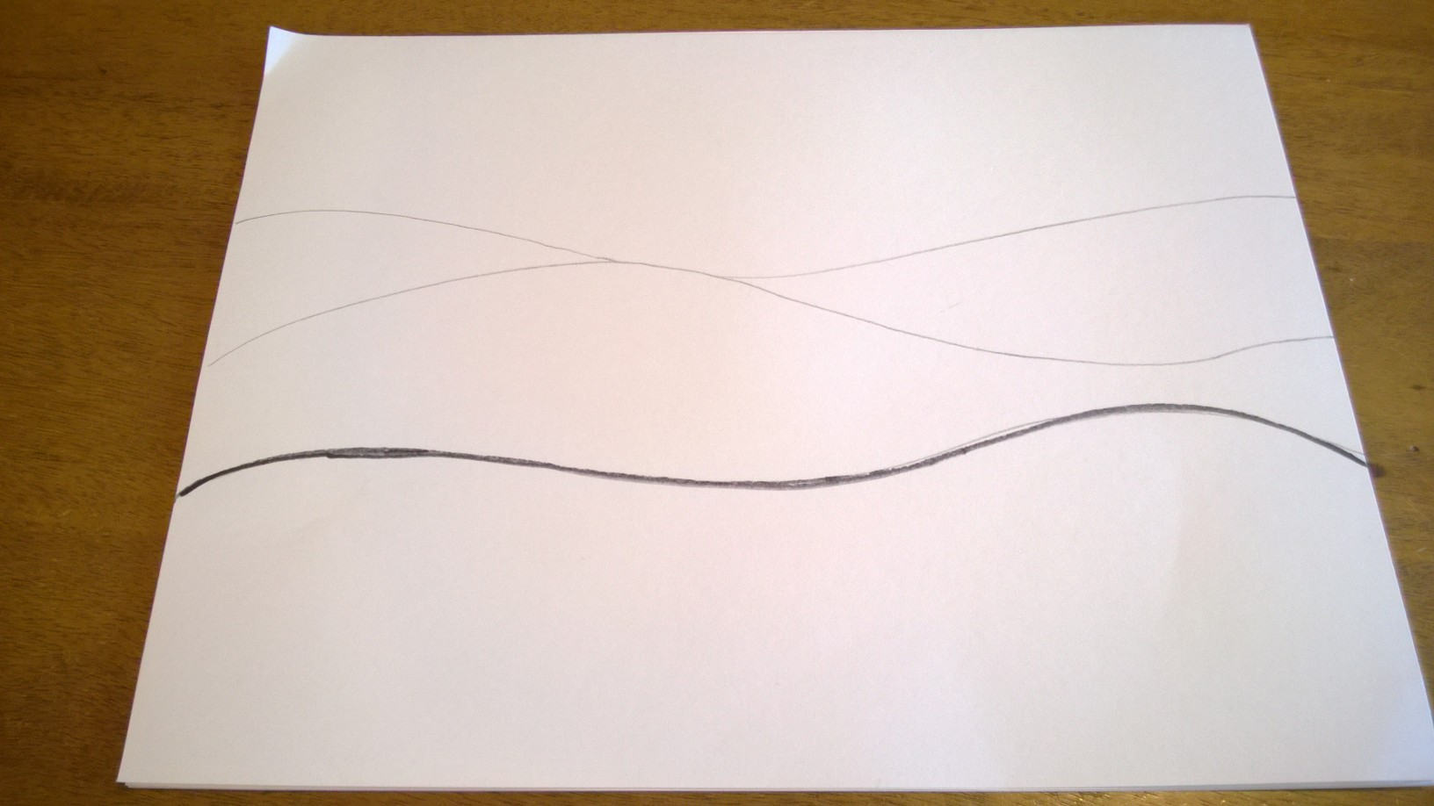
• Write your name on one side and turn it over
• Find the middle of your paper with your finger
• Draw a wavy line a little bit below your finger

Slide 3
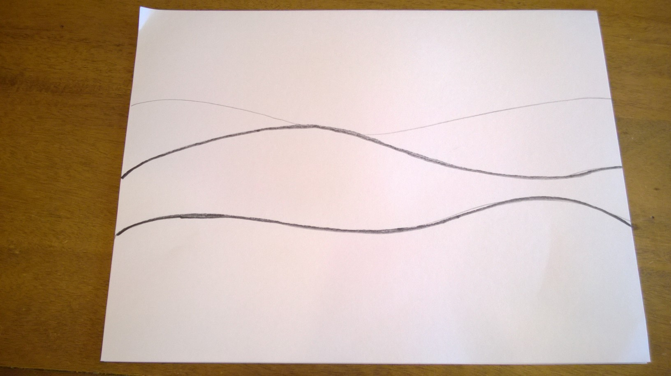
• Draw a second wavy line above the first one.

Slide 4
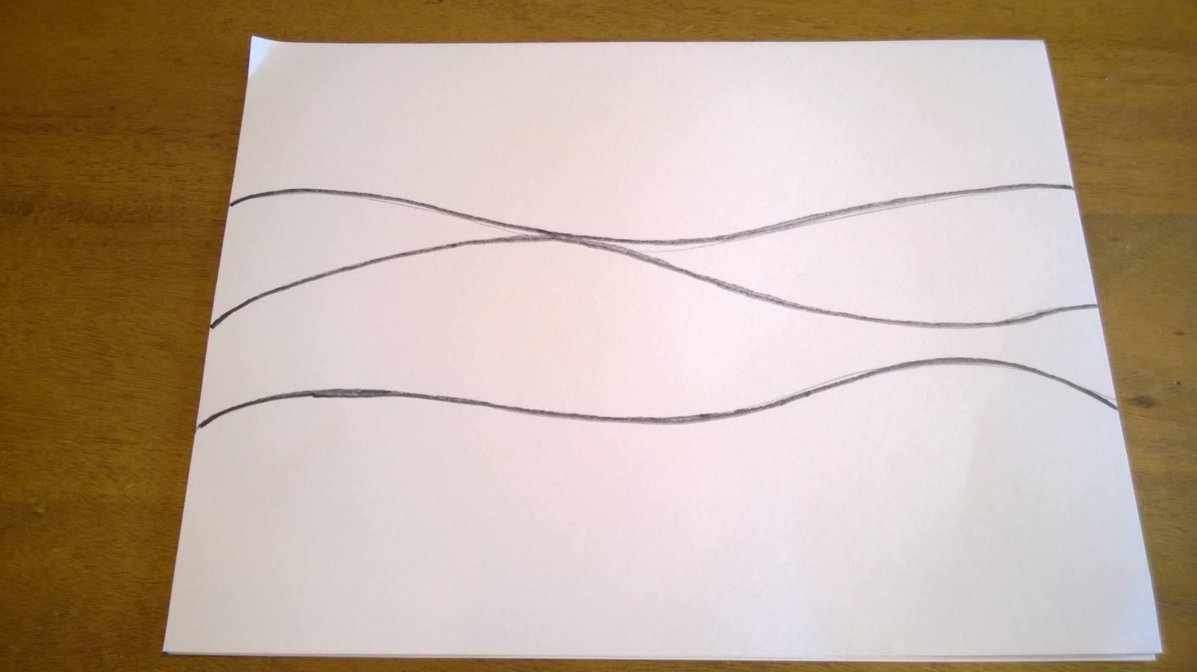
• and a 3rd line and a 4th line

Slide 5
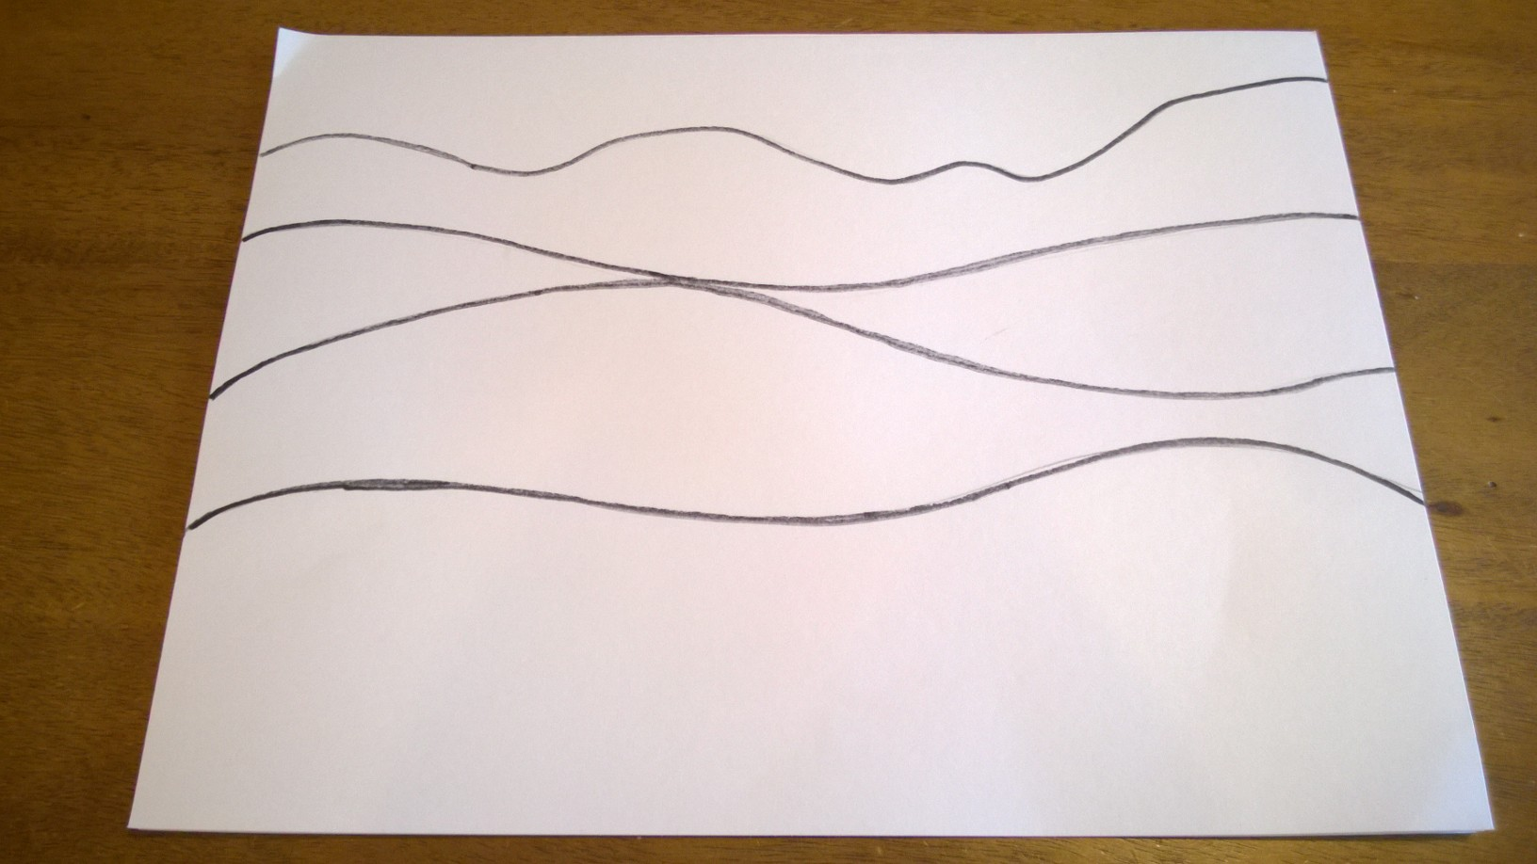
• You should have 4 lines making 5 spaces
• Number your spaces from 1 at the top to 5 at the bottom, very lightly in pencil

