Slide 1
Explore art

Slide 2
SPACE
Element of art

Slide 3
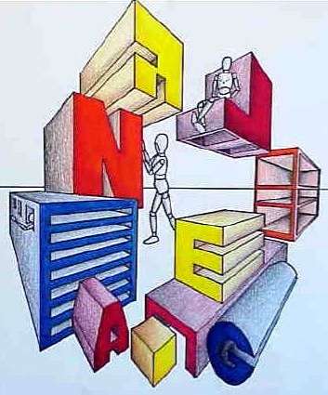
What is SPACE in art?
Space in art refers to the emptiness or area between, around, above, below, or within objects

Slide 4
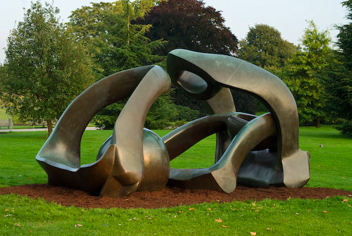
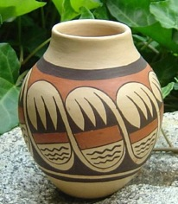
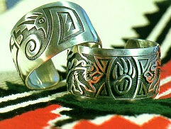
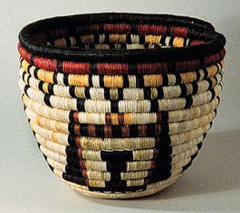
3D Space
3-D space can Be Defined as the space over, under, through, behind, and around a form.
Architecture, sculpture, weaving, ceramics and jewelry are
3-dimensional art.

Slide 5

The feeling of 2-D
space in a drawing
or painting is
ALWAYS
An illusion

Slide 6
How is the illusion created?

Slide 7
Linear Perspective
OVERLAPPING
Size
STOP
STOP
PLACEMENT
VALUE & COLOR
DETAIL
Notes:
Simple overlapping
Overlapping objects is a helpful tool for creating an illusion of 3D. Depending on how it is applied it can give a sense of deep or shallow space within a composition.

Slide 8
Art can also be looked at as Positive and Negative space – The image being the positive space and the space around it being the negative space
Notes:
Changing Size and Placement
We see how a distant image is smaller than a foreground image and by putting an image on a different level gives it the feel of being in the distance.

Slide 9
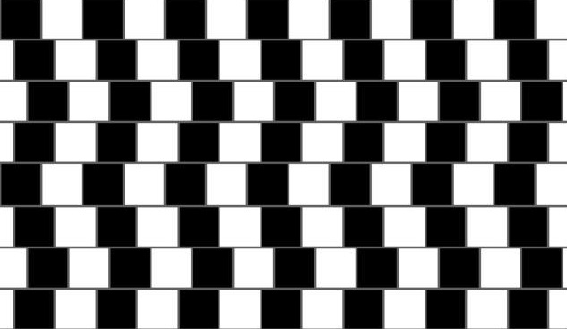
Here are some fun images using positive and negative space
Are these lines straight?

Slide 10
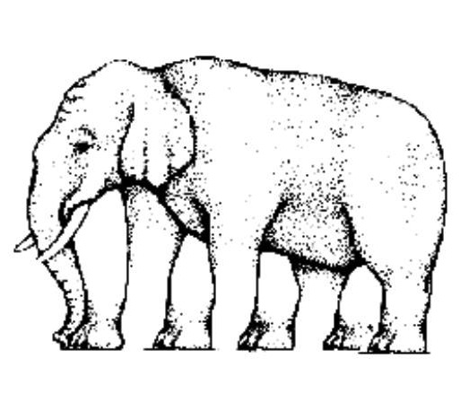
How many legs does this elephant have?

Slide 11

Which image has the largest center?

Slide 12

Is this a mans face or a word?

