Slide 1
Explore art

Slide 2
SHAPE
Element of art

Slide 3
What is shape in art?
• Flat
• closed space
• Has height and width

Slide 4
Geometric shapes

Slide 5
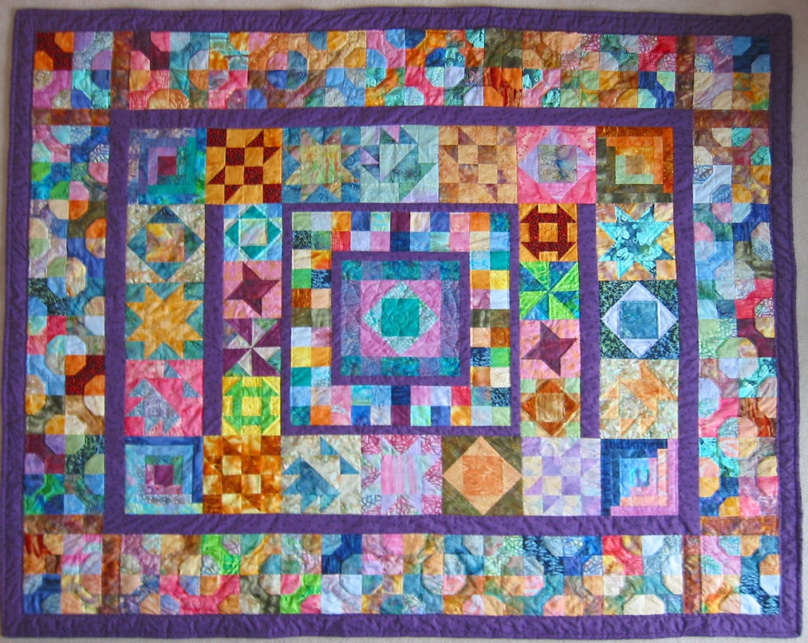

Slide 6
Freeform or organic shapes

Slide 7
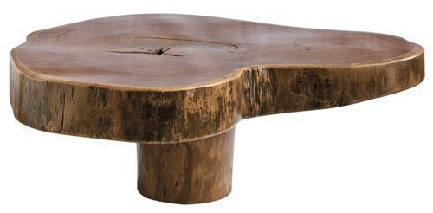
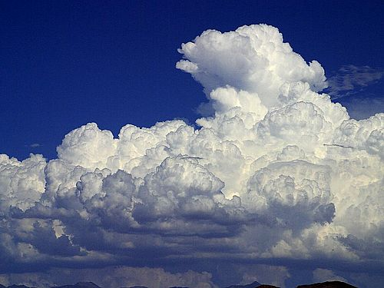
Freeform or organic shapes in nature

Slide 8
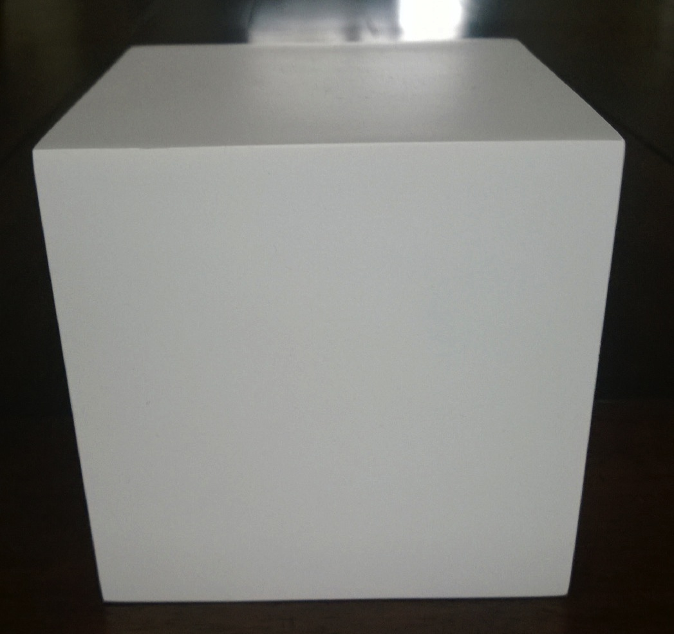
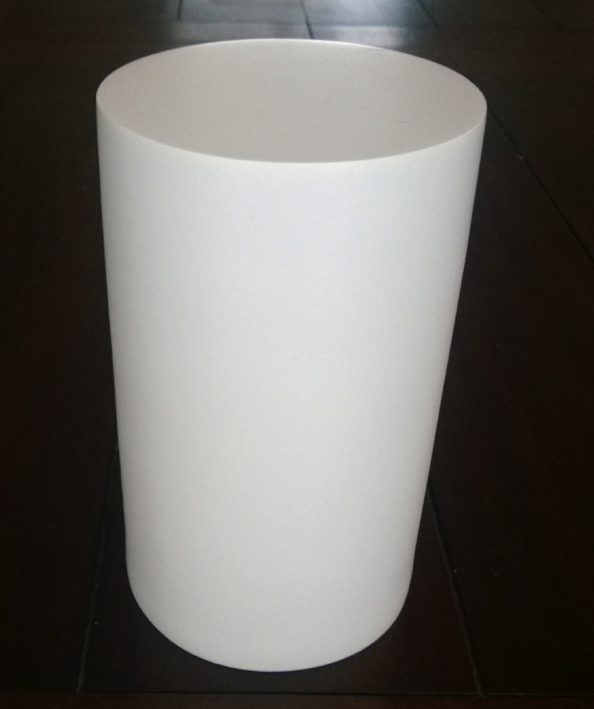
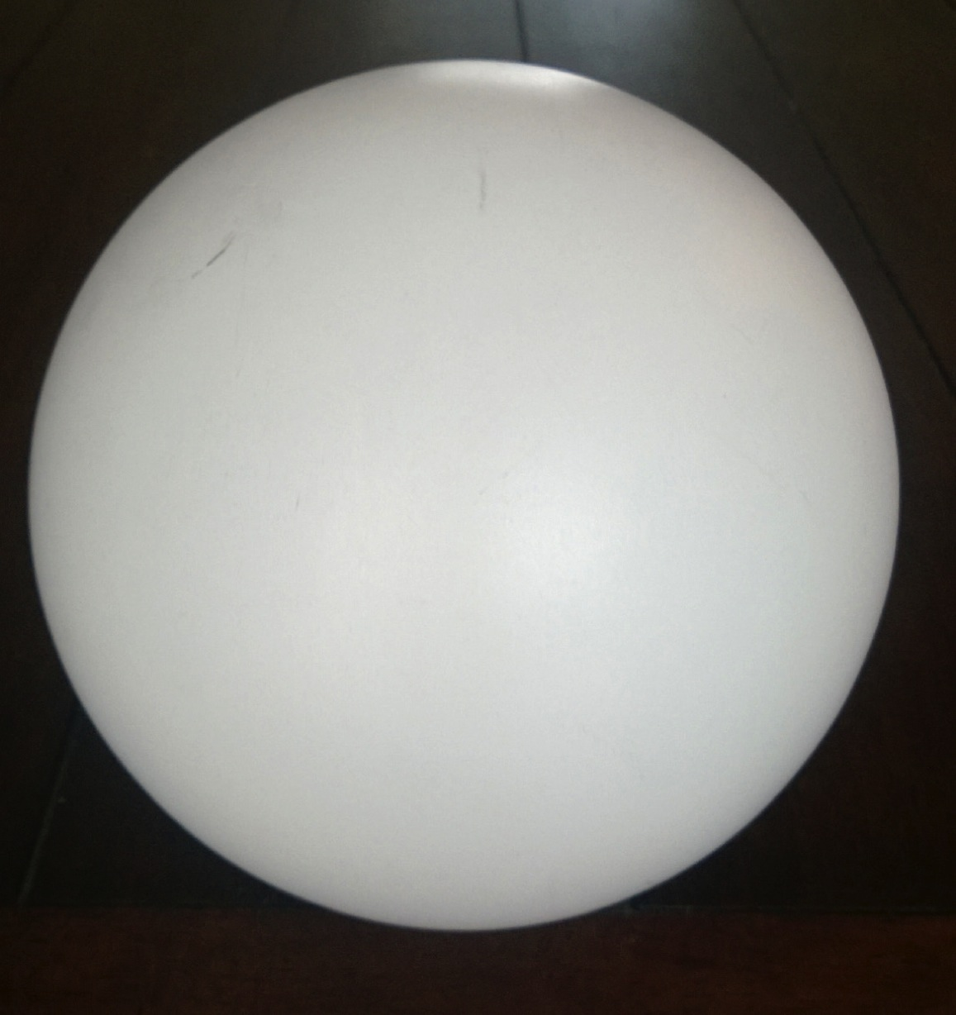
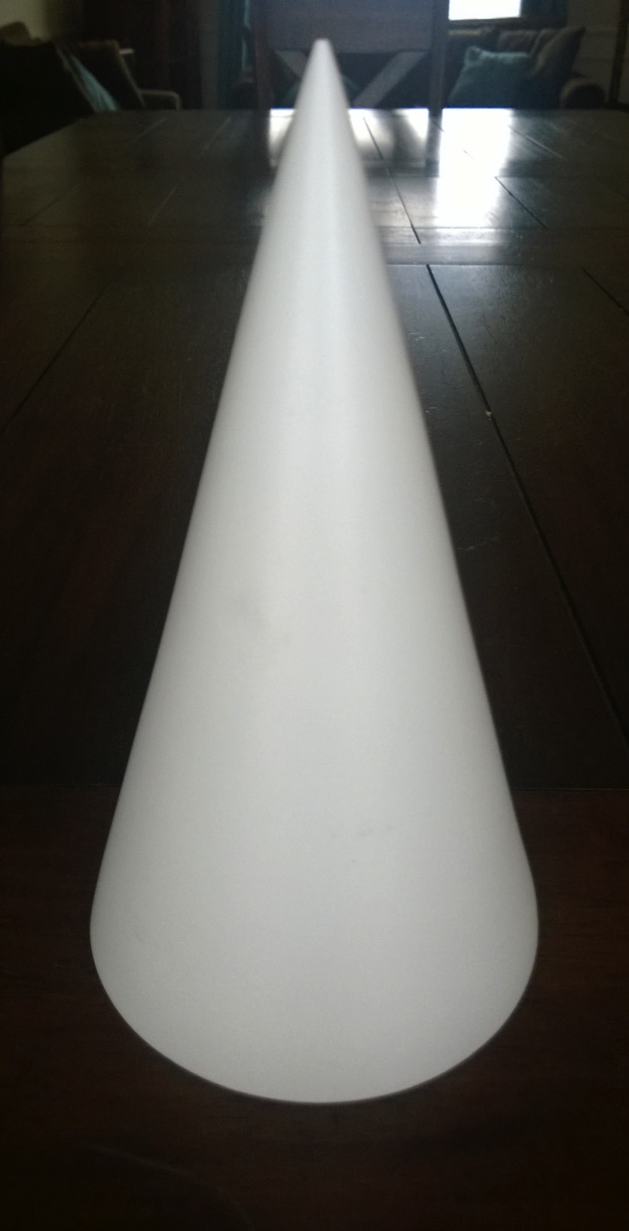
Everything we see around us can be make up from 4 basic shapes
• Cube – Square
• Cylinder – Rectangle
• Sphere – Circle
• Cone – Triangle
Trying to draw something complicated becomes so much easier
when we can divide what we’re seeing into simple shapes.

Slide 9
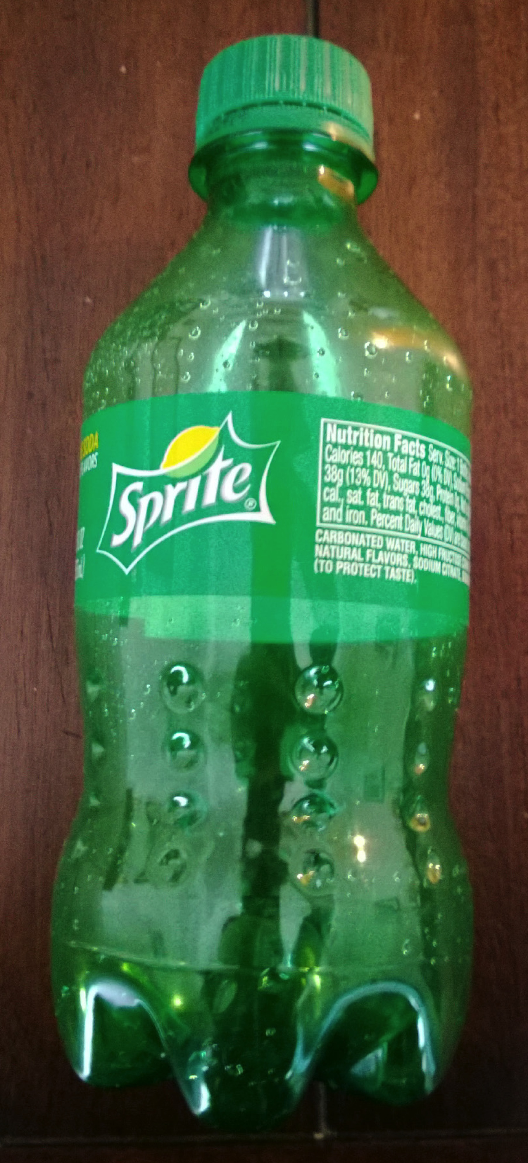
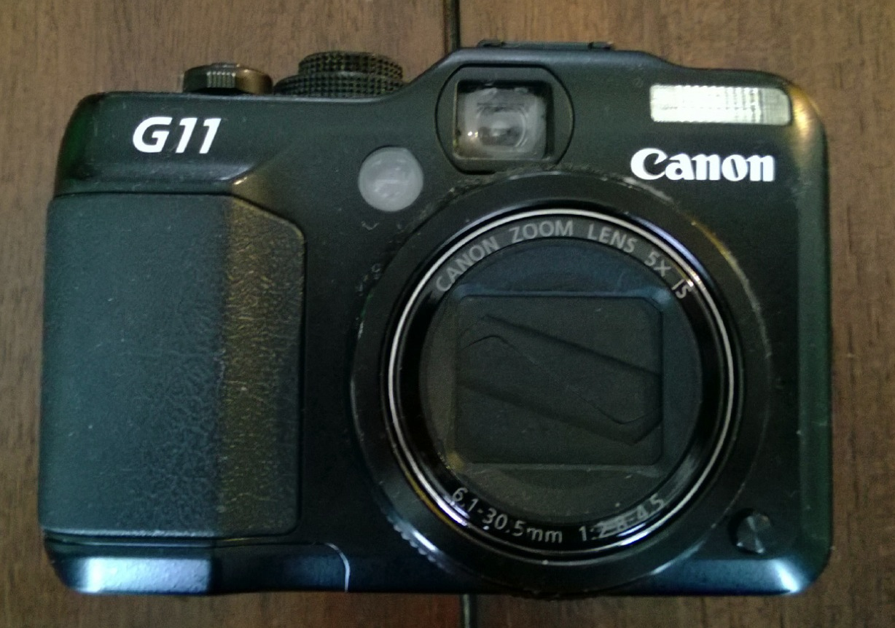

Slide 10
Positive and negative shapes

Slide 11

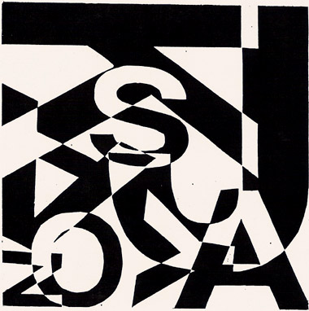

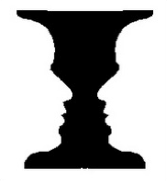
Positive and negative shapes

