Slide 1
Explore Art

Slide 2
Principles of Design
Pattern

Slide 3
What is pattern?
Patterns are things that repeat over and over and patterns are made in Art when the same shapes or images are repeated again and again.’

Slide 4
What is pattern?
Patterns can be regular or irregular. Regular patterns appear where elements are carefully controlled and repeated accurately.

Slide 5
What is pattern?
Whereas irregular patterns are found with random repeated elements that don’t seemed planned, as found in nature

Slide 6
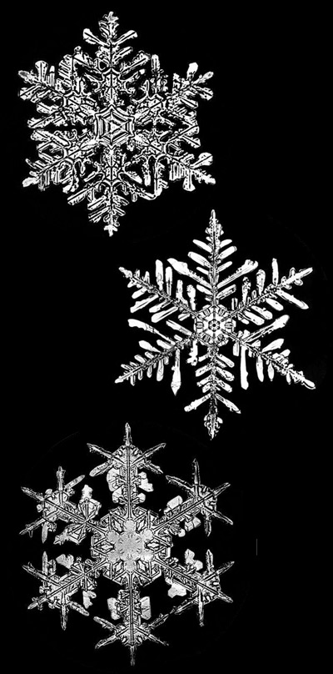

Slide 7
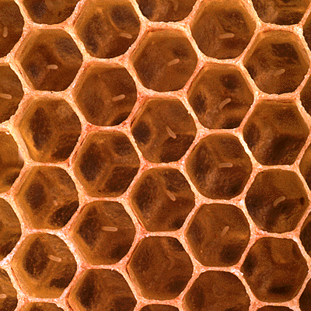

Slide 8
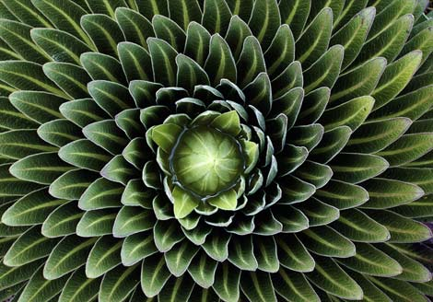

Slide 11
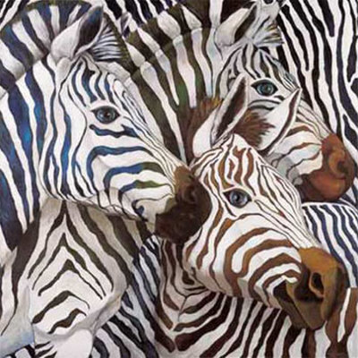
Patterns in nature
Zebra
Do you recognize this pattern?

Slide 12
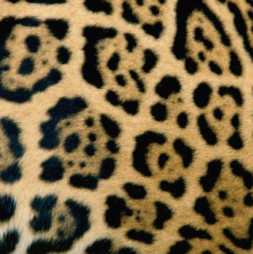
Patterns in nature
Jaguar
Do you recognize this pattern?

Slide 13
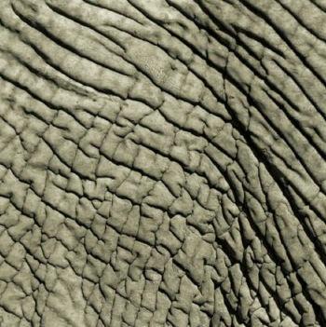
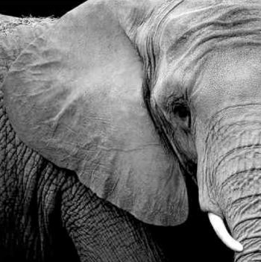
Patterns in nature
Elephant
Do you recognize this pattern?

Slide 14
Patterns in nature
Parrot
Do you recognize this pattern?

Slide 15
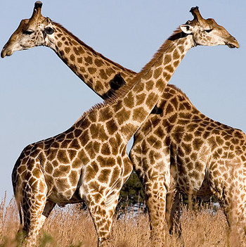
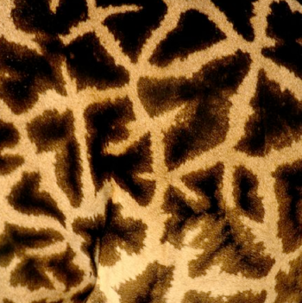
Patterns in nature
Giraffe
Do you recognize this pattern?

Slide 16
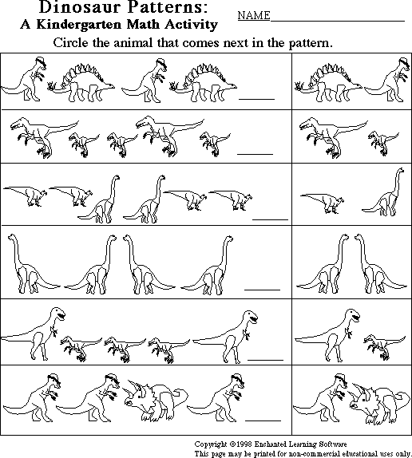
We learn early on in our education about the patterns in mathematics

Slide 17
Kaleidoscope

Slide 18
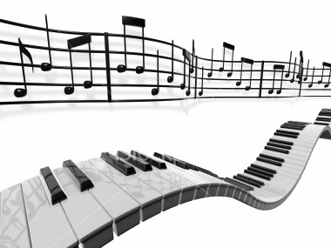
Even a song is a pattern of notes

Slide 19
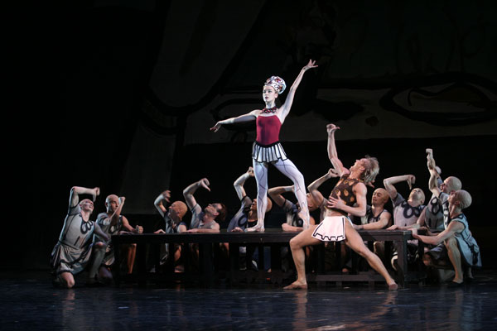
A dance is a pattern of movements

Slide 20
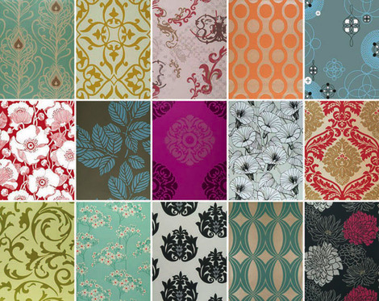
At home we might see patterns on…
Wallpaper

Slide 21
Curtains

Slide 22
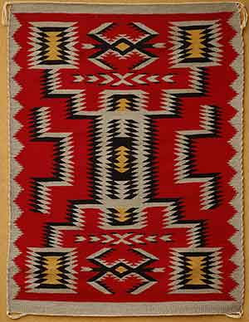
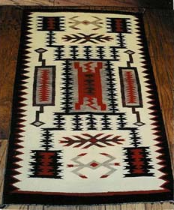
Rugs

Slide 23
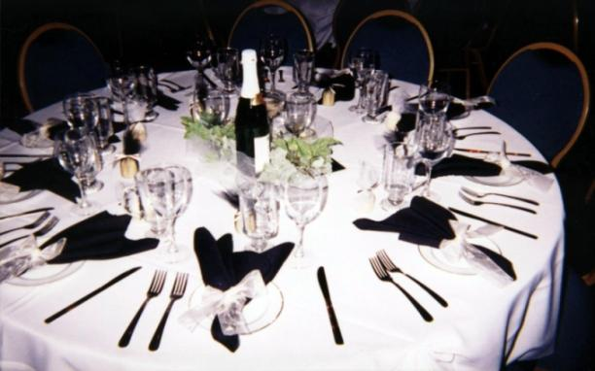
And even table settings have pattern

Slide 24
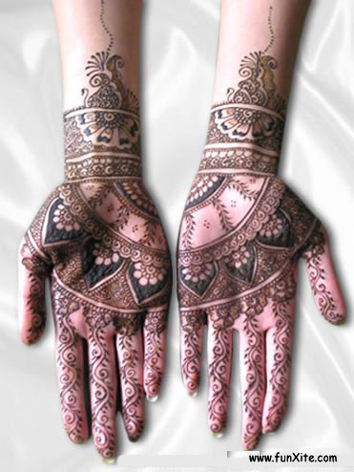
Some cultures paint themselves with beautiful intricate patterns

Slide 25
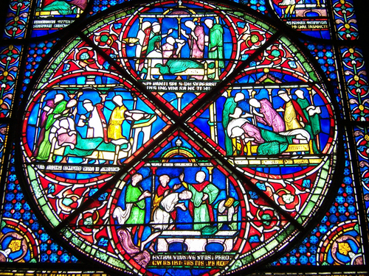
The Rose Window at Canterbury Cathedral England

