Slide 1
Explore art

Slide 2
Elements of Art
form

Slide 3

What is form?
Form is the element of art that describes a shape with three dimensions.
HEIGHT
WIDTH
DEPTH

Slide 4
What is form?
• Unlike a flat shape drawn on paper, you can view a form on all sides.
• Sometimes each view is the same and sometimes it’s different.
• We are surrounded by forms, both natural and man-made.
Just like shapes, forms are described as either geometric or free-form

Slide 5
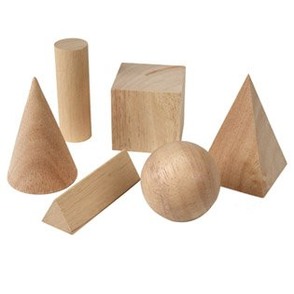
Geometric forms
Geometric forms are precise and regular.
We know cubes, pyramids, cylinders, spheres and cones.

Slide 6
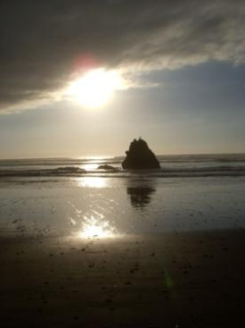
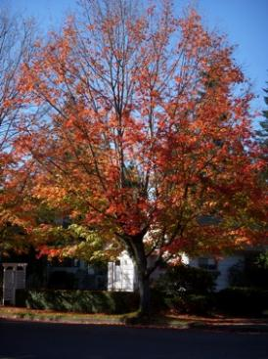
Free-form
• Free-form objects are irregular and uneven.
The natural world is full of free-form objects – trees, rocks, clouds, and even you! Anything that has height, width and depth and does not have a precise and regular shape is described as free-form.

Slide 7
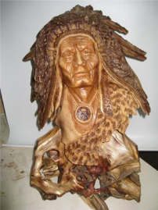
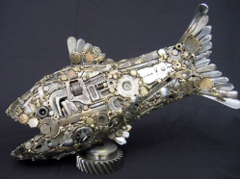
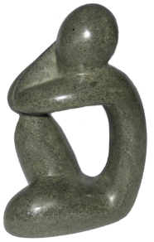
Sculptures in different materials
wood
Artists use form to create 3-D works of art called sculpture.
They use many different techniques and different materials, including: wood, metal & stone…
m e t a l
s
t o n e

Slide 8
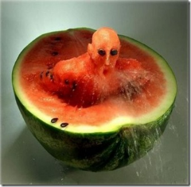
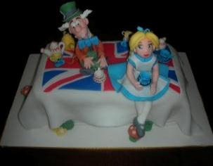
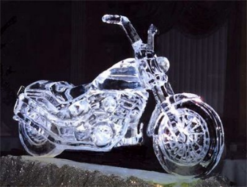
f
ood
food, fondant, ICE…
f o n d a n t
i
c
e

Slide 9
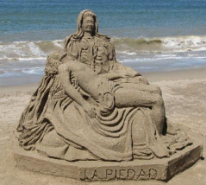
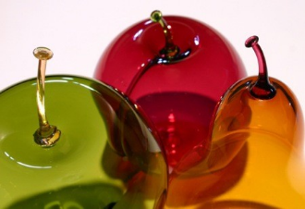
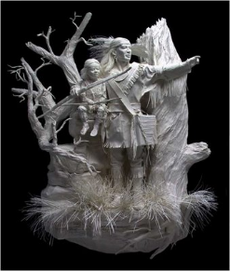
sand
sand, glass, paper…
g l a s s
Pape
r

Slide 10
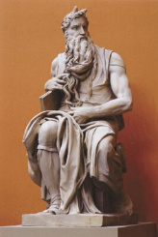
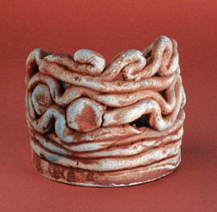
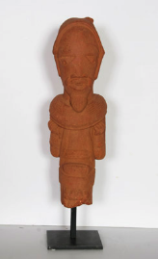
CLAY…

