Slide 1
Explore art

Slide 2
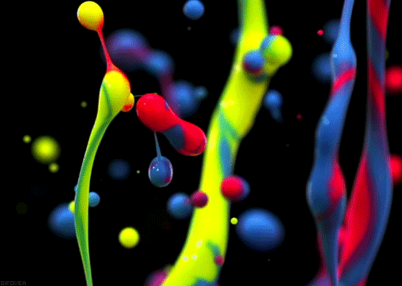
COLOR
Element of art

Slide 3
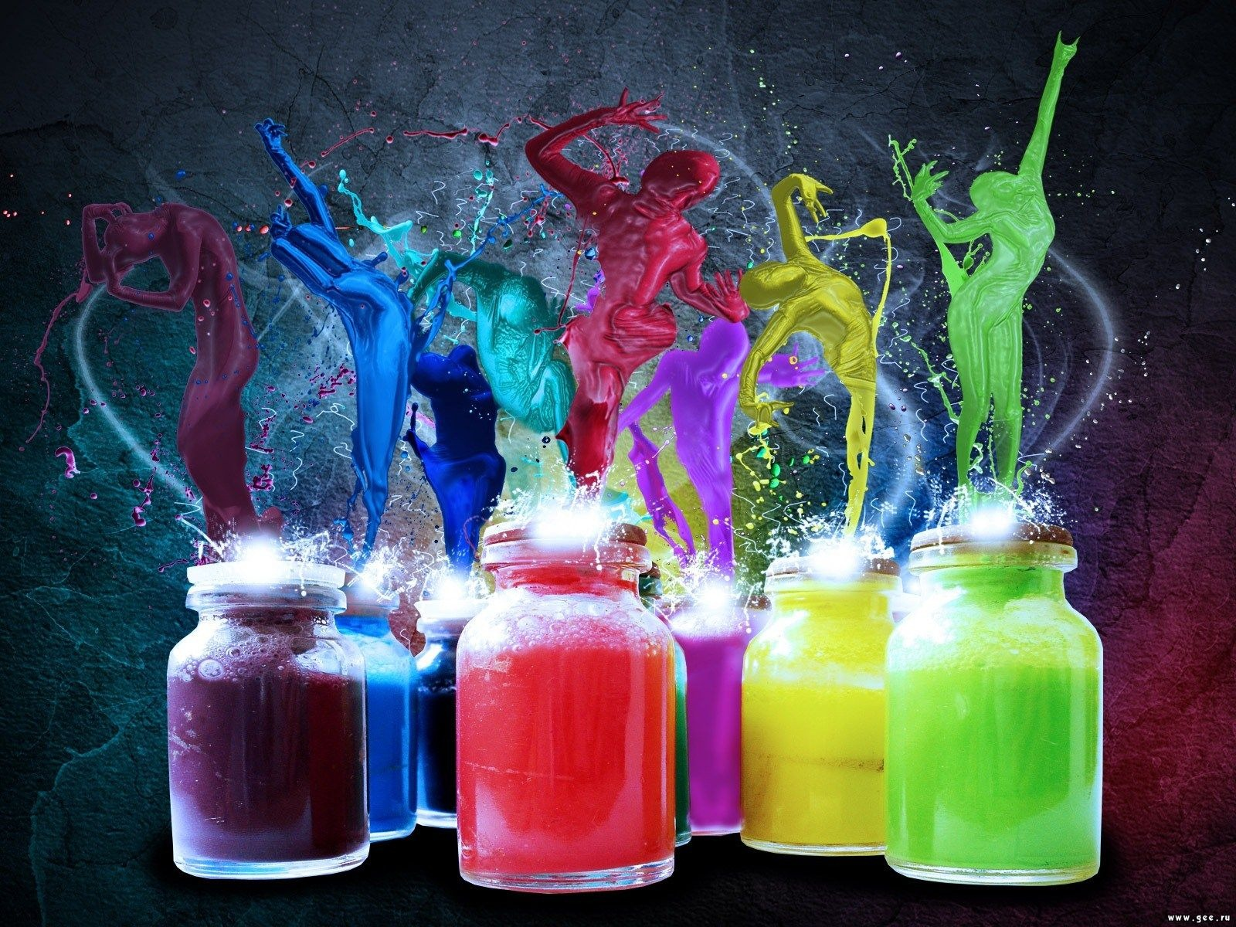

Slide 4
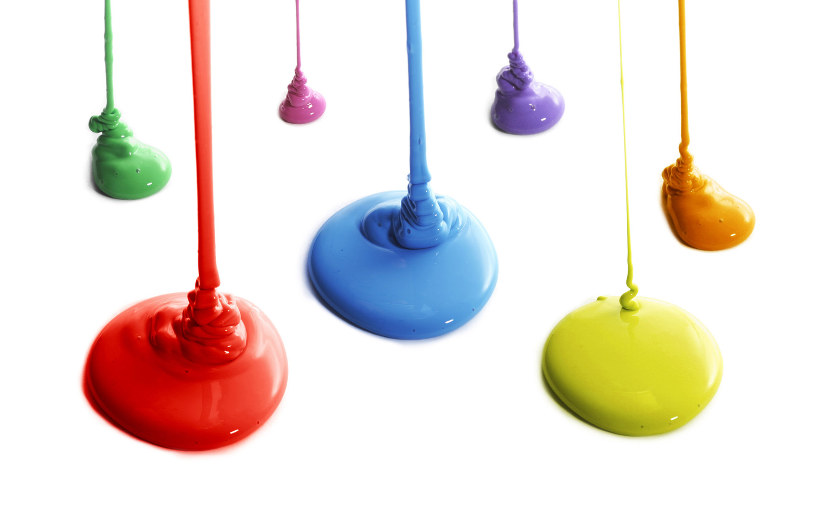
Properties of Color
There are 3 properties of color –
Hue, Value and Intensity

Slide 5
HUE
Another word for color. Hue refers to a pure color – one without shade or tint.

Slide 6
VALUE
The darkness or lightness of color. A color’s value changes when white or black is added.

Slide 7

INTENSITY
The brightness or dullness of a color.
High intensity= color is strong and bright; Low intensity= color is faint and dull

Slide 8
Primary Colors
Colors which cannot be mixed in pigment from other hues…
Notes:
It may surprise you to see the relationship between geometric shapes, which sounds like math class, and creating a piece of art. But geometric shapes can create a striking visual effect when you repeat them to create patterns, as shown in this quilt.
Even though this quilt uses many colors and patterns of material, the repeated geometric shapes bring a sense of orderliness and unity to the piece

Slide 9
SECONDARY Colors
Are directly mixed from combinations of primary colors.

Slide 10
TERTIARY Colors
Further combinations of primary and secondary colors create tertiary

Slide 11
Complimentary Colors
Colors that are opposite to each other on the color wheel are considered to be complementary colors.

Slide 12
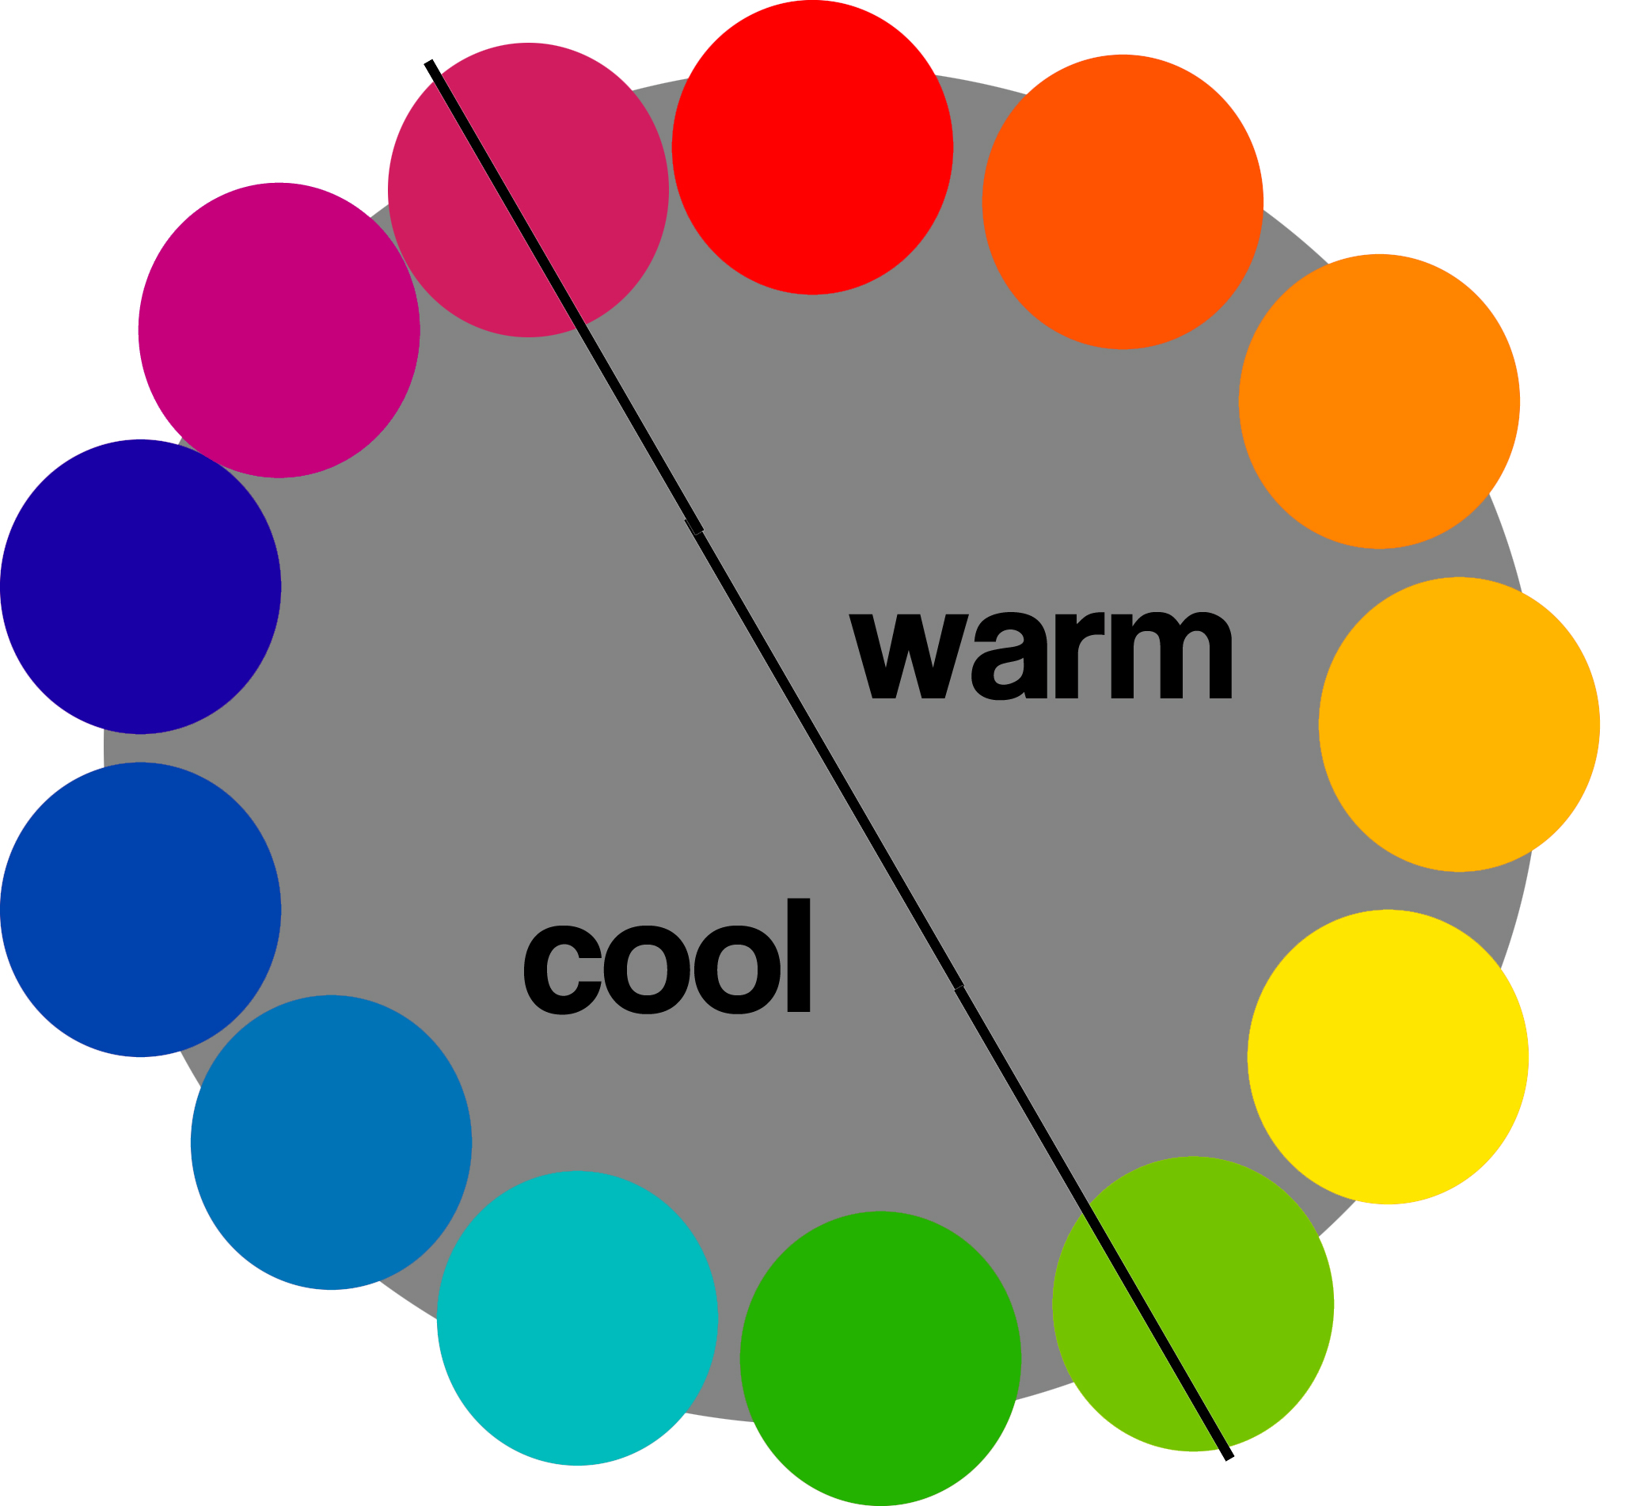
Cool and Warm Colors
Color can be divided into three groups: warm colors, cool colors, and neutrals.
Warm colors are vivid and energetic, and tend to advance in space.
Cool colors give an impression of calm, and create a soothing impression.
White, black and gray are considered to be neutral.

Slide 13
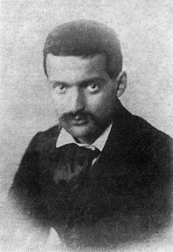
Today’S Featured Artist
Paul Cézanne
1839 -1906
• Father of Modern Art
• Frenchman
• Distinct style
• Short brush stroke
• use of bright colors

Slide 14
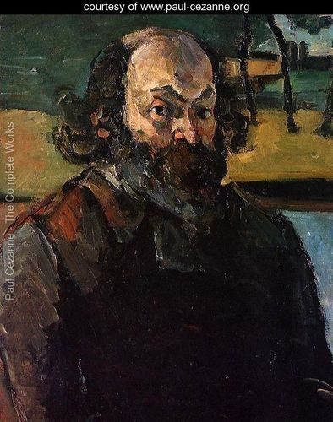
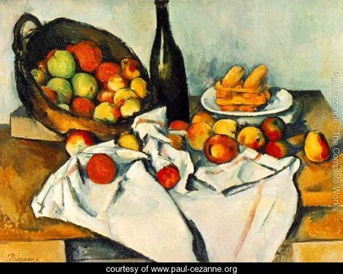
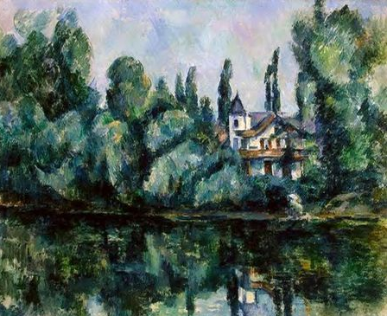
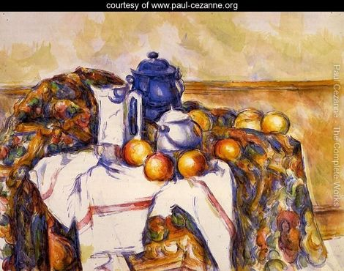

Slide 15
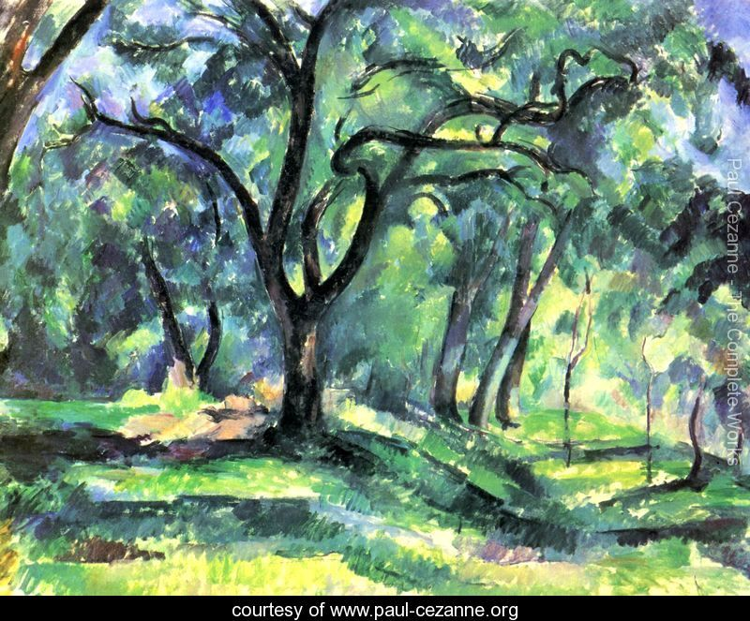

Slide 16
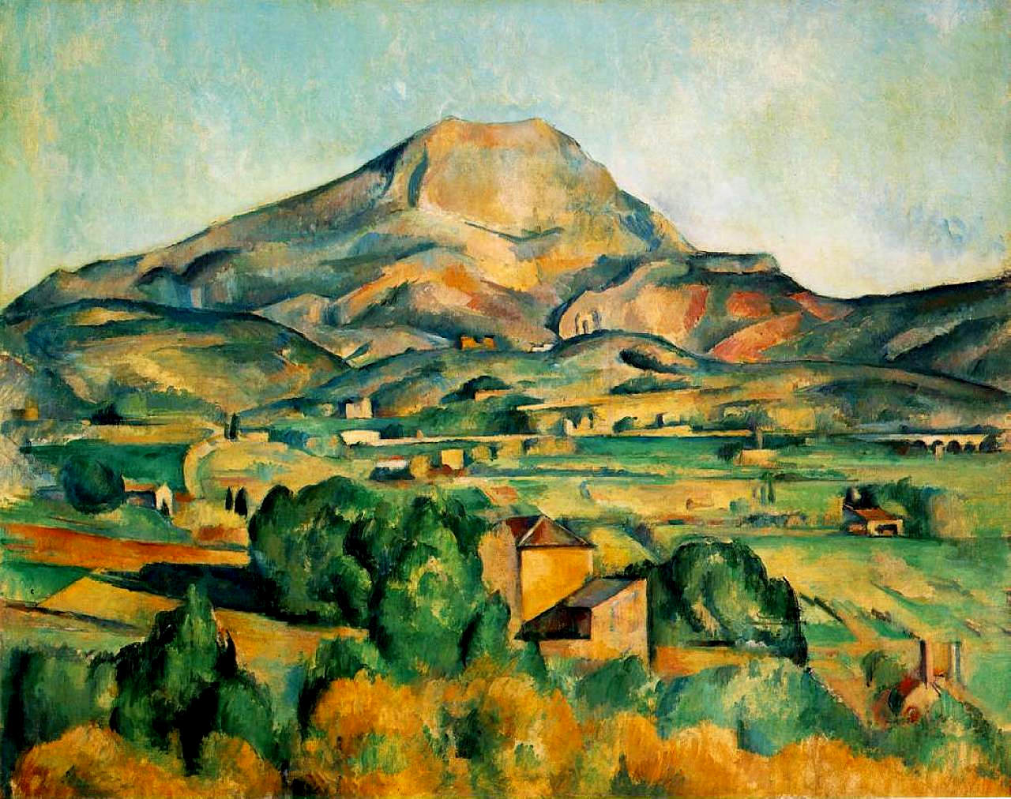

Slide 17
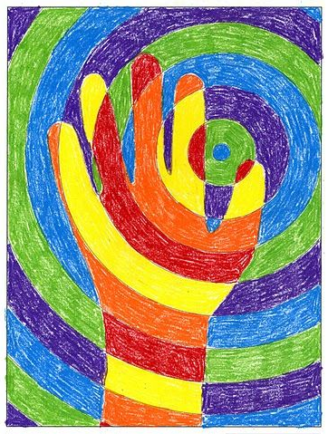
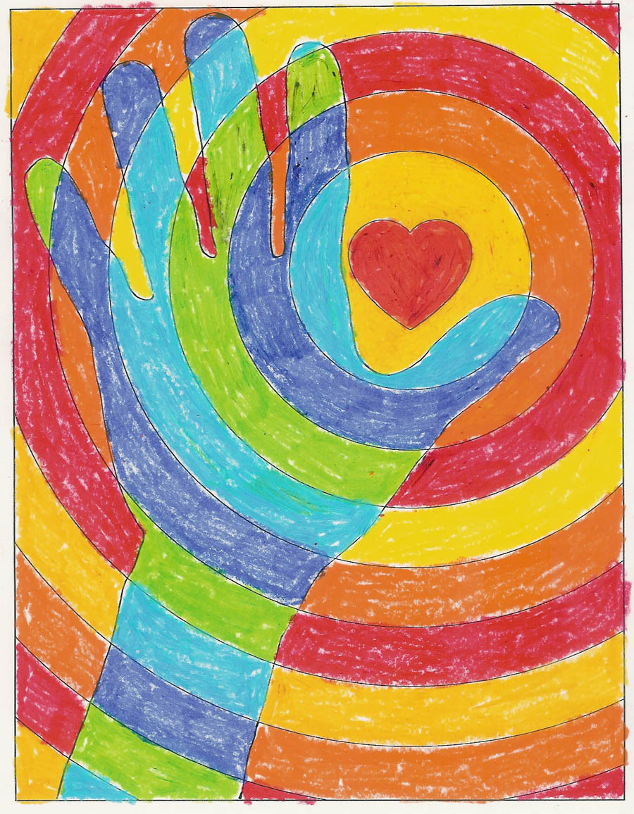
Our project today warm and cool hand

Slide 18
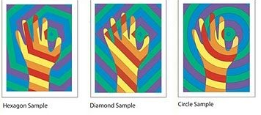
Our project today warm and cool hand Variations

Slide 19
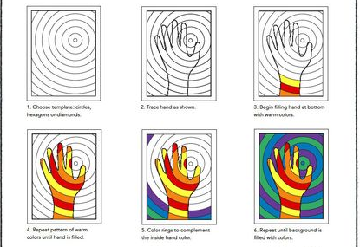
Our project today warm and cool hand

Slide 20
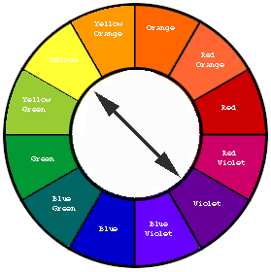
Have fun with the color wheel!
Can you identify the complementary colors?

