Slide 1
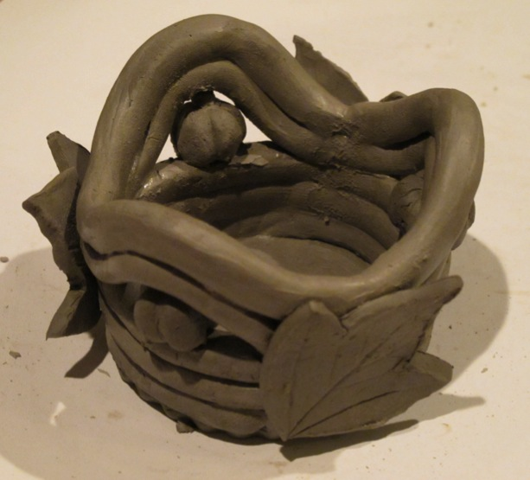
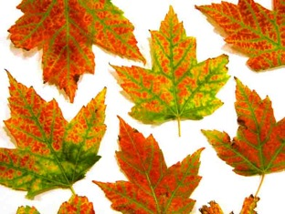
Project - coil harvest pot

Slide 2
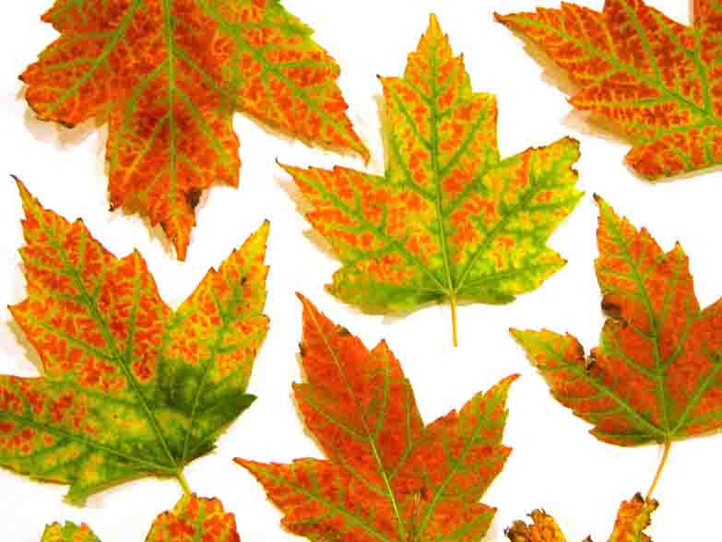
Project - coil pot
Step 1
Cut clay in quarters.

Slide 3
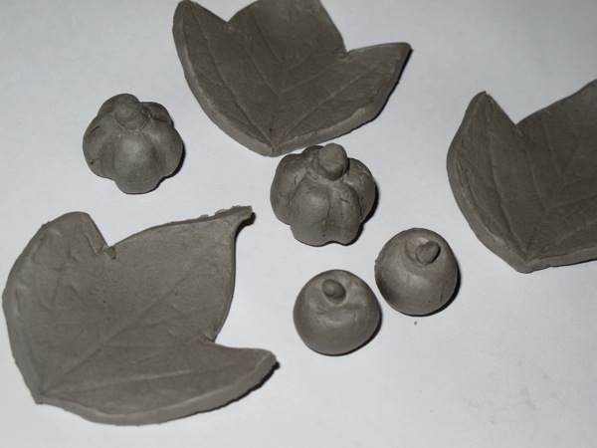
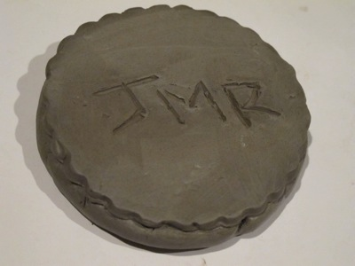
Project - coil pot
Step 2
Roll out 1 quarter no thinner than a quarter of an inch and cut out 3 leaf shapes, base and make 3 small fruit shapes.
Make sure you carve your initials in the circle that is your base, then turn it over.
Remember:
you need to score and add slip to every edge of your clay that touches to make it glue together.

Slide 4
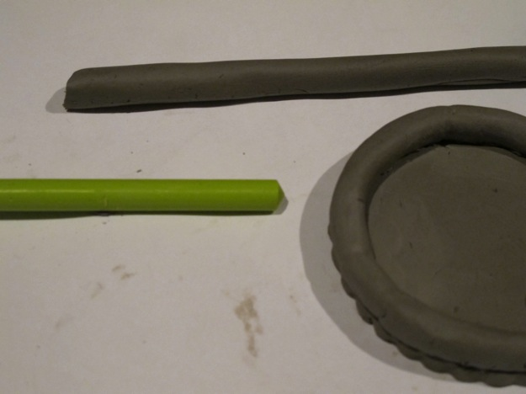
Project - coil pot
Step 3
From the other 3 quarters of clay, roll out long coils, using a forward rolling motion with the hand held straight, using the palms and gentle pressure, then lift it back towards you.
These should look like long sausages and must be thicker than a pencils width.
Remember:
you need to score and add slip to every edge of your clay that touches to make it glue together.

Slide 5
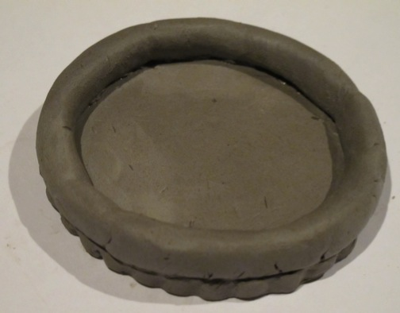
Project - coil pot
Step 4
Start to make the pot:
Use 1 sausage to start with, score and add slip to both edges - this is MOST IMPORTANT this is your glue - before joining edges together, move gently until you feel it is bonded.
Pinch off and smooth together ends when it is wrapped around slab and they meet. Build 3 rows high.
Remember:
you need to score and add slip to every edge of your clay that touches to make it glue together.

Slide 6
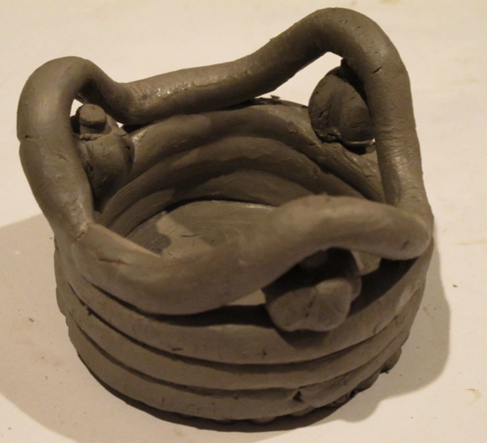
Project - coil pot
Step 5
As you build the coils lute the inside of the pot. To do this use a finger to squish and smooth the clay from each of the joined piece together at the contact point.
Add the 3 fruits along the top edge equally distanced, gluing them with scoring and slip.
Remember:
you need to score and add slip to every edge of your clay that touches to make it glue together.

Slide 7
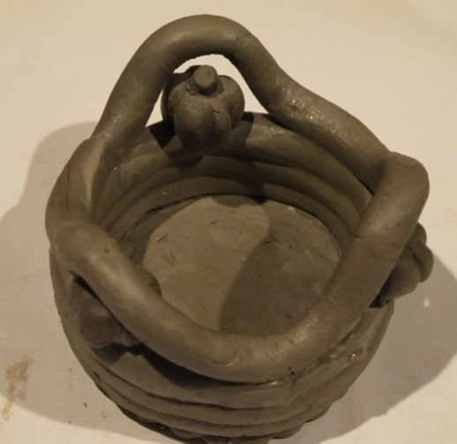
Project - coil pot
Step 6
Add a coil in a wave to go over the fruits
Remember:
you need to score and add slip to every edge of your clay that touches to make it glue together.

Slide 8
Project - coil pot
Step 7
Add 1 more rows of coil to finish the pot
Any cracks or marks can be smoothed over with slip.
Remember:
you need to score and add slip to every edge of your clay that touches to make it glue together.

Slide 9
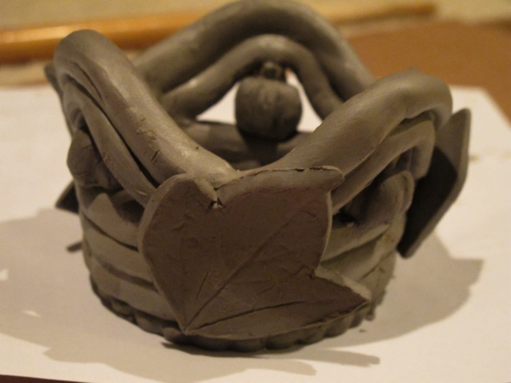
Project - coil pot
Step 8
Stick the slightly curled leaves to the outside of the pot
Remember:
you need to score and add slip to every edge of your clay that touches to make it glue together.

